Slide 1
Automated Segmentation of clothing ensembles from Pinterest
Monica Stettler
November 15, 2018
481 Image Processing

Slide 2

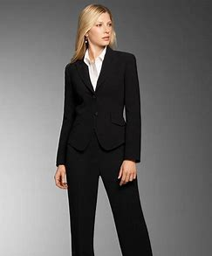
the problem

Slide 3
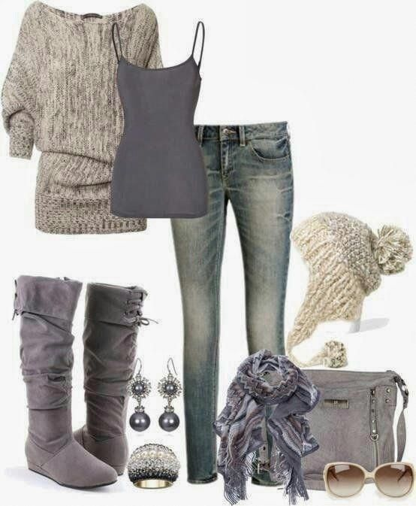
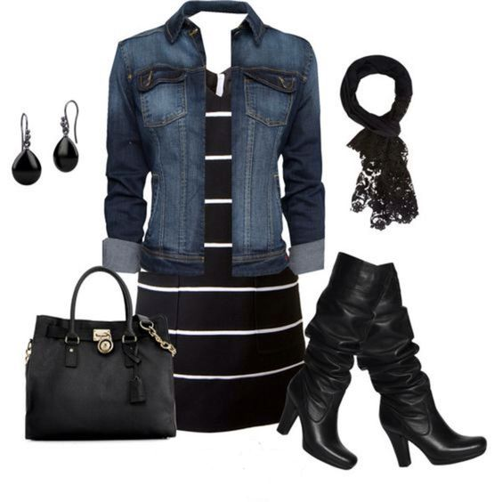
the discovery

Slide 4
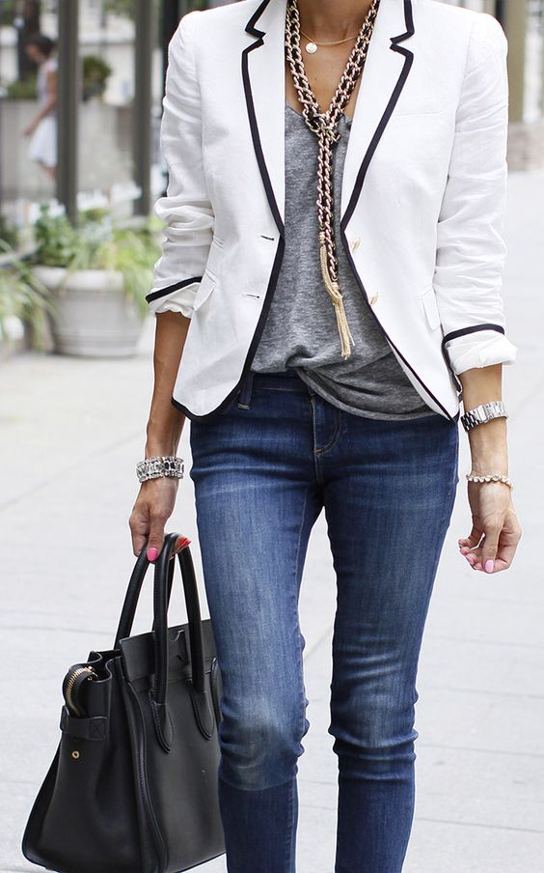
new challenge

Slide 5
how to buy all the pieces in a fashion blogger’s Pinterest image post?
Click through takes you to fashion blogger’s site, but they don’t sell the clothes
Food bloggers all have links to buy items they promote!
App search is disappointing
*One app can only accept a single isolated item and links to suggestions ranging from $400-$5,000 for a blouse
*Another app is manually set up behind the scenes. Site works with select fashion bloggers and retailers. You can click through for their specific bloggers and specific retailers

Slide 6



the frustration
This Photo by Unknown Author is licensed under CC BY-SA
This Photo by Unknown Author is licensed under CC BY-SA

Slide 7
goal
to automatically segment a Pinterest clothing ensemble image such that each item is its own image
ultimate goal : to use the image generate from above step to match to images on retail sites and ultimately find the item and purchase

Slide 8
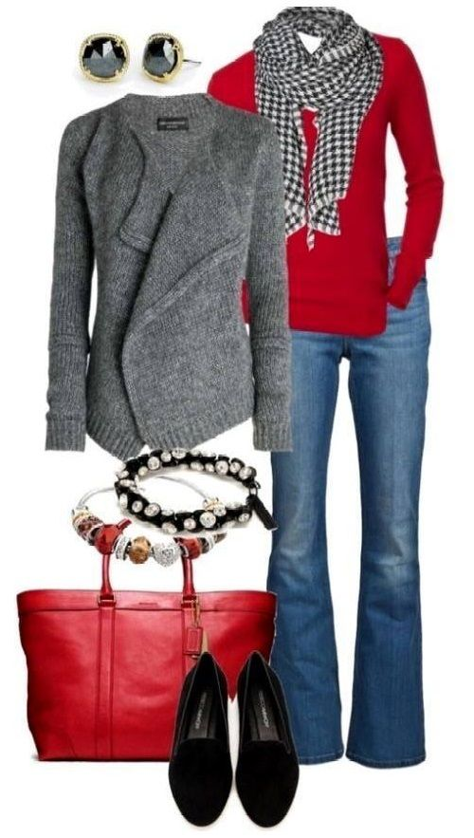


Slide 9
background research
most of the papers I read, focused on isolating one object or they used tags and metadata as clues

Slide 10
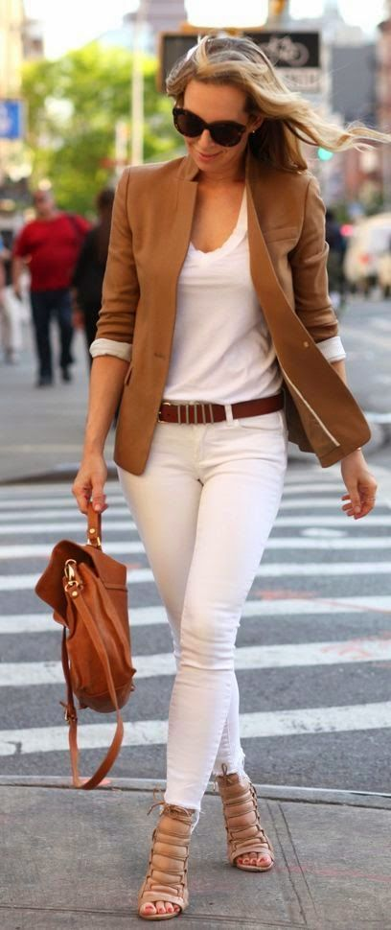
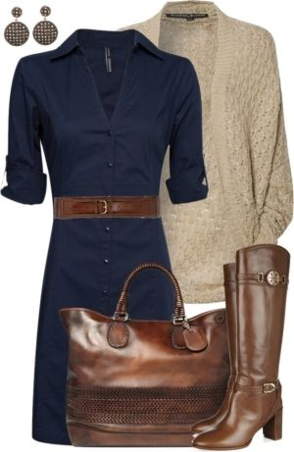
keep it simple
no
only use images:
white background
no models
yes

Slide 11
challenges: matching or similar colors
9 items
6 items
many pieces in ensemble - varies per outfit
9 items

Slide 12
getting started
before I worked on automating the process, I needed to execute the process manually
much of what we have done in class is dependent on color and intensity, which only helps me for the first cut

Slide 13
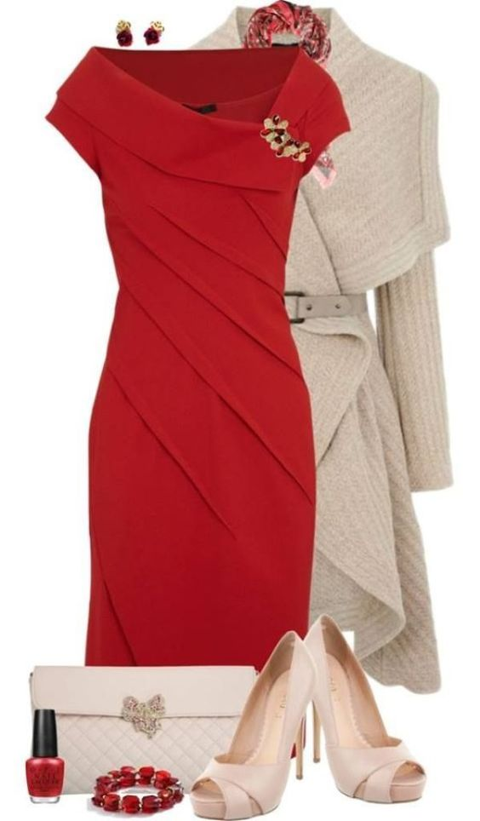
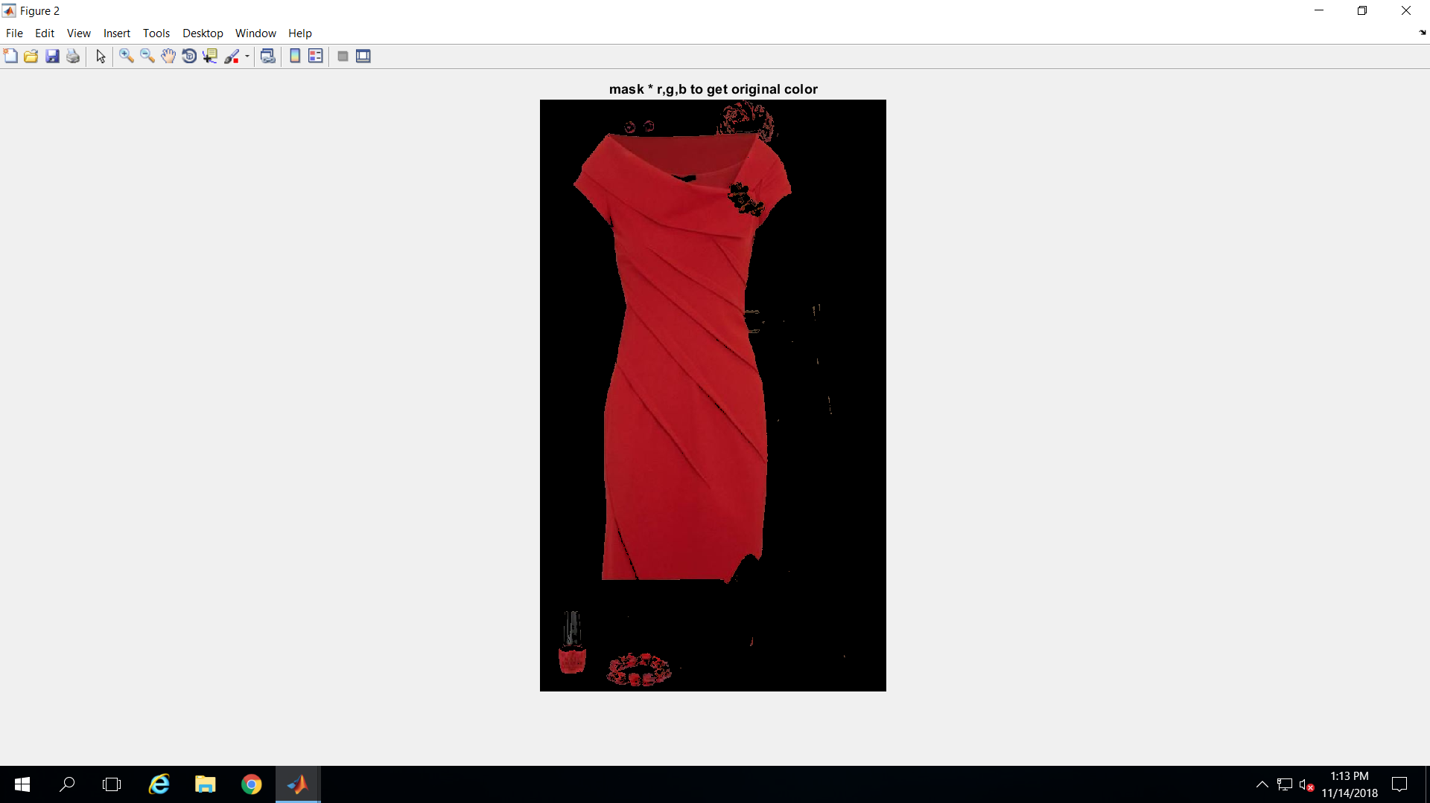
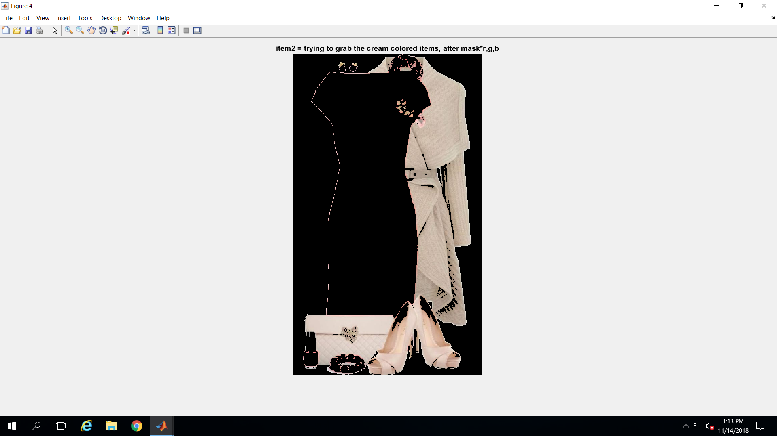
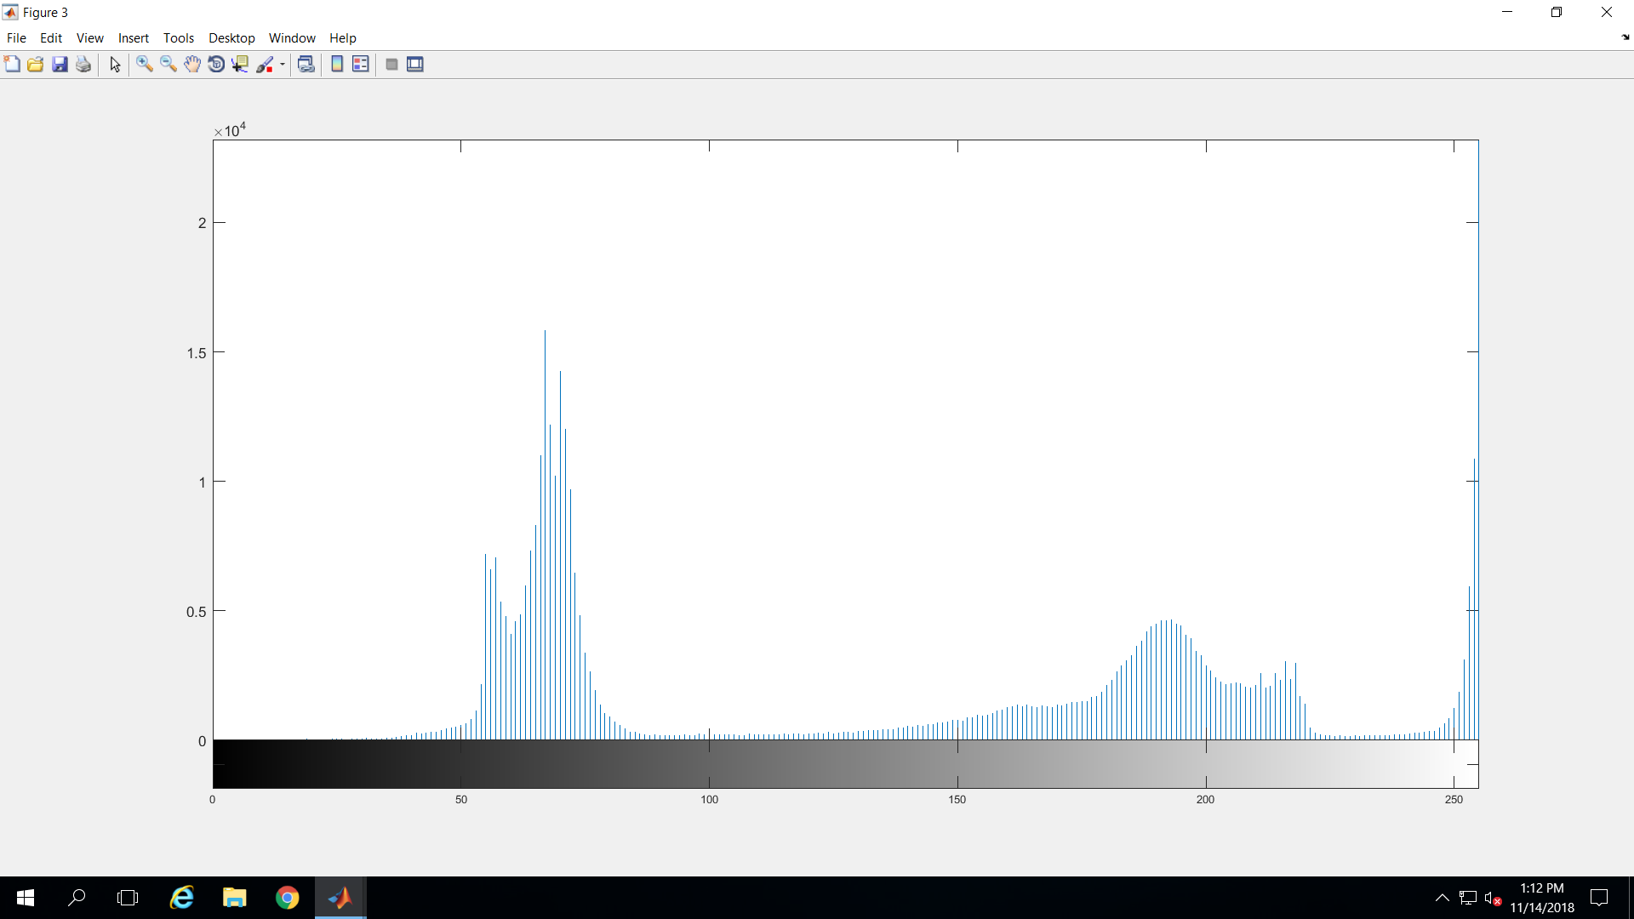
thresholding – is the goal possible manually?
manual pick T=140-230
grabs all cream items
reconstructed color looks weird
histogram on grayscale image
original
manual pick T=40-90
grabs all red items

Slide 14
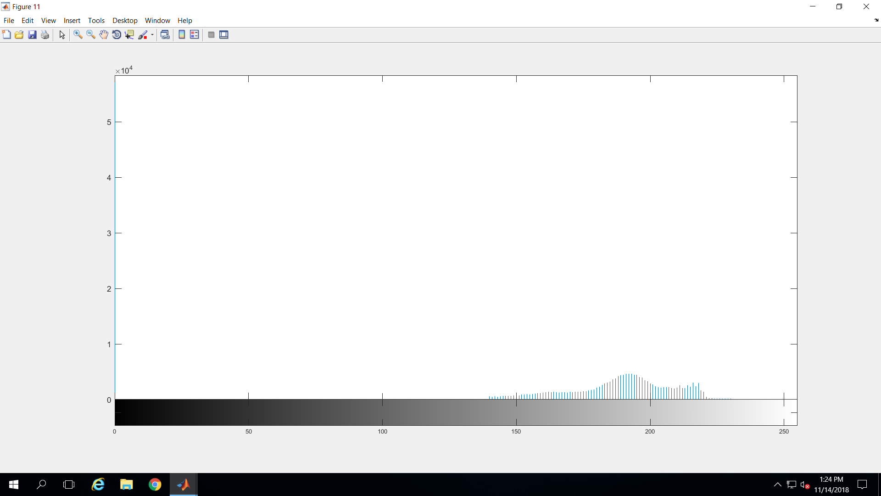
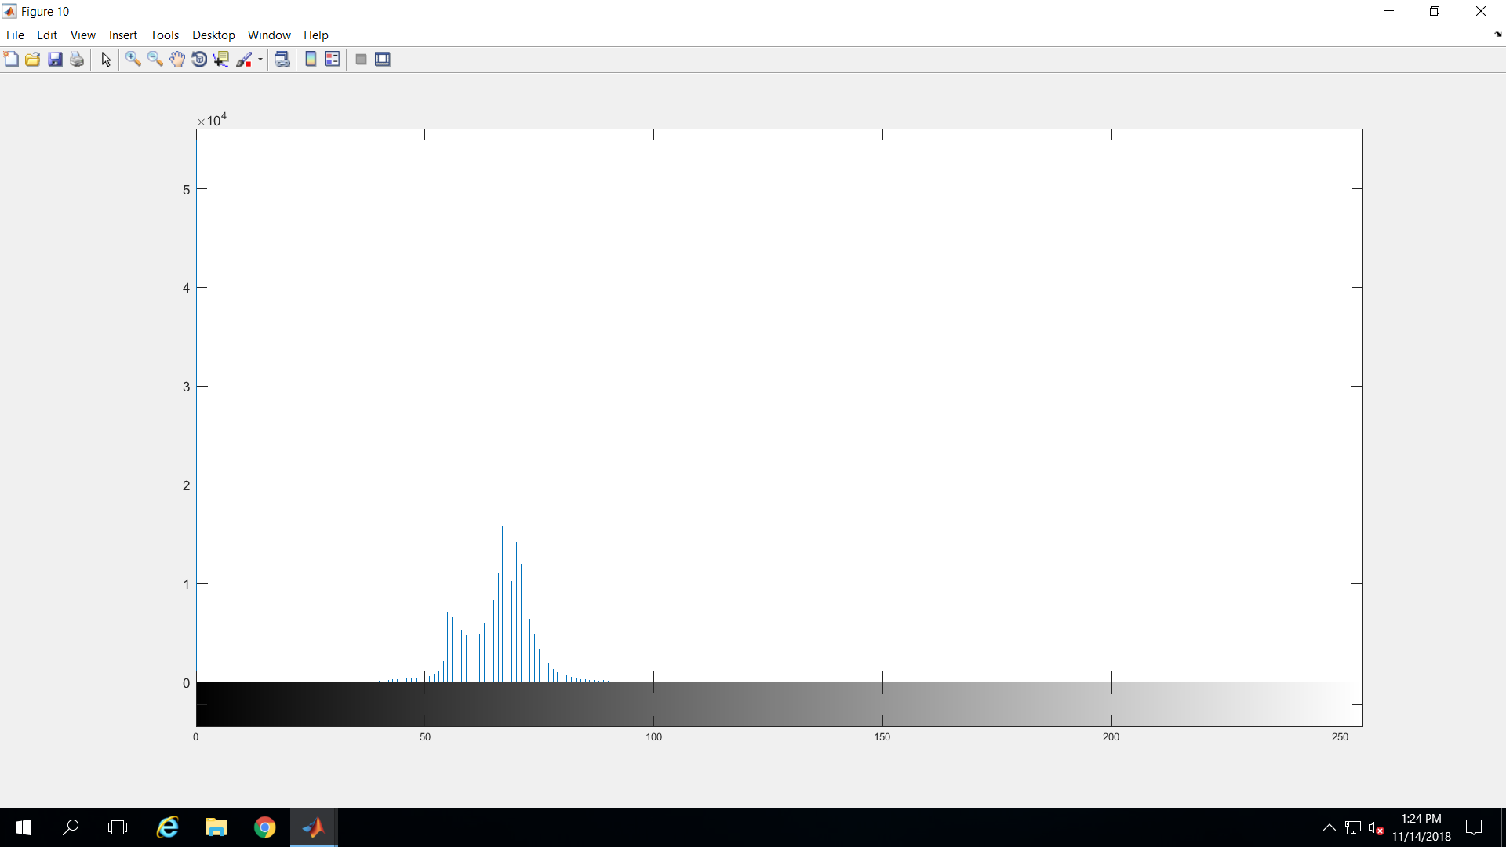
thresholding – part 2?
would histograms of the segmented images possible provide additional information, or finer details to make further cuts? – NOPE!
note: the histogram for the red gives a tease with the dip, but cutting there ruins the color

Slide 15
methods
I tried pretty much everything…
thresholding -could not separate items of similar color or intensity
my ‘best’ method for automation was ‘bwareafilt()’, which works on object size
I set program to automatically run 10 iterations (I assumed max 10 objects to segment)
images must be converted to binary

Slide 16
bwareafilt(i)
extracts all connected components (objects) from the binary image and returns a binary image containing only those object that meet the criteria
-range
-n largest
-n smallest
-specify pixel connectivity that defines the objects

Slide 17
automatic steps
TRANSFORM – convert to grayscale
CONVERT – convert image to binary
APPLY – apply ‘bwareafilt’ tool
RETURN – return original color to segmented image
BACKGROUND – swap background from black to white
CUT – remove the item from the original grayscale image
REPEAT – repeat with grayscale image minus item(s)

Slide 18
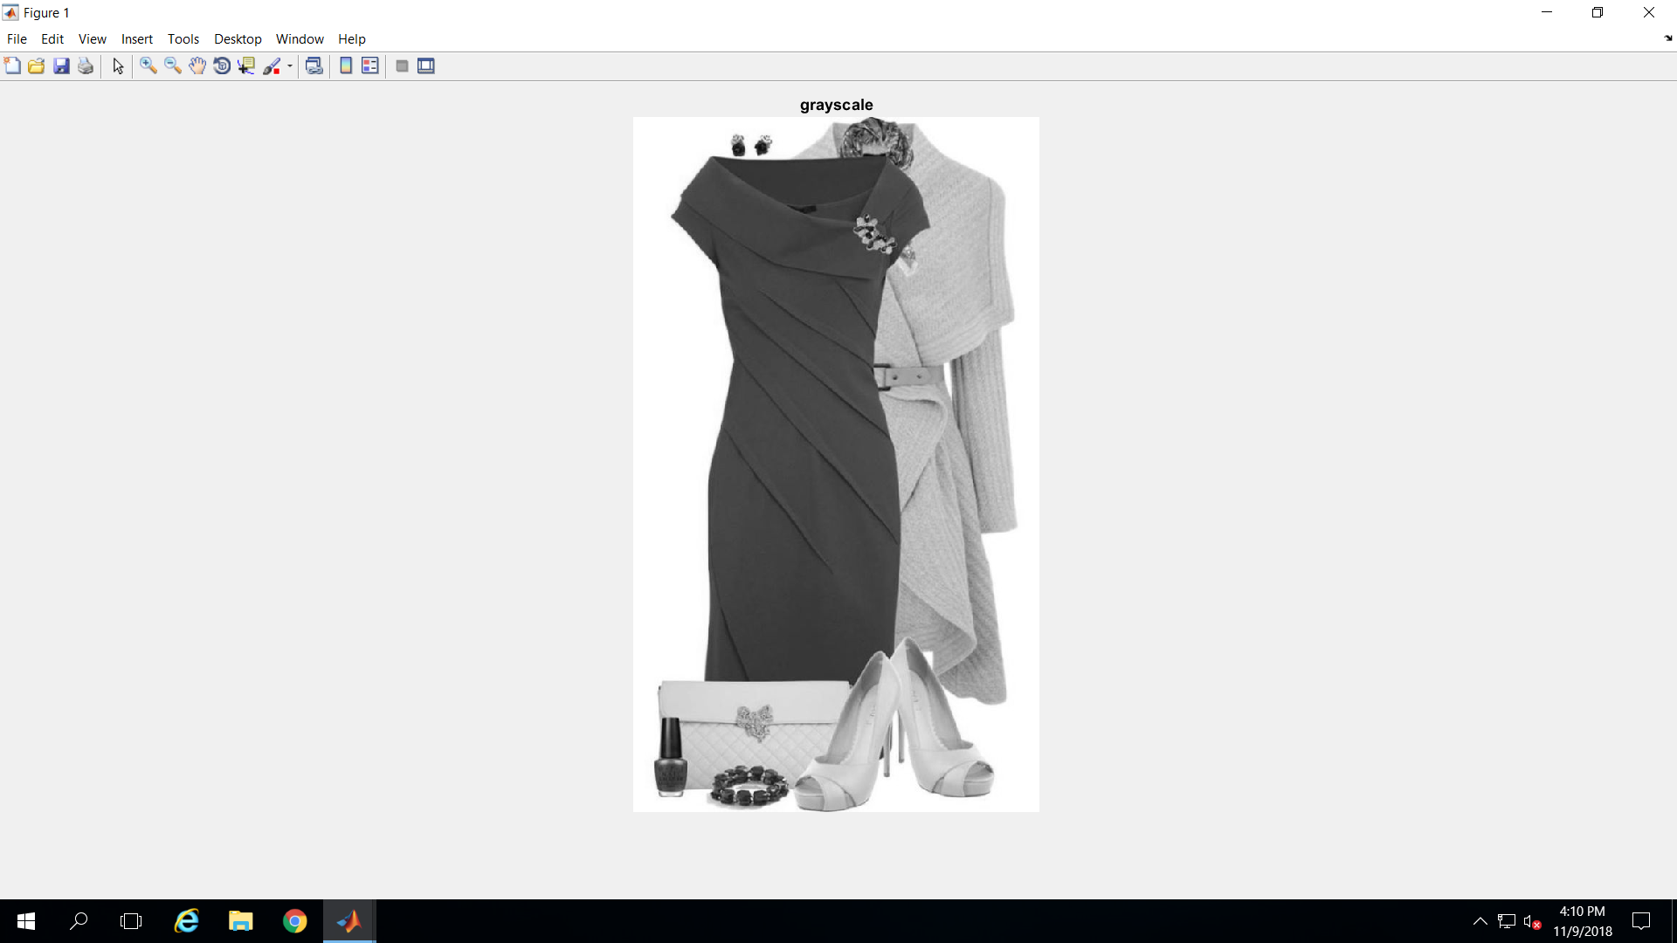
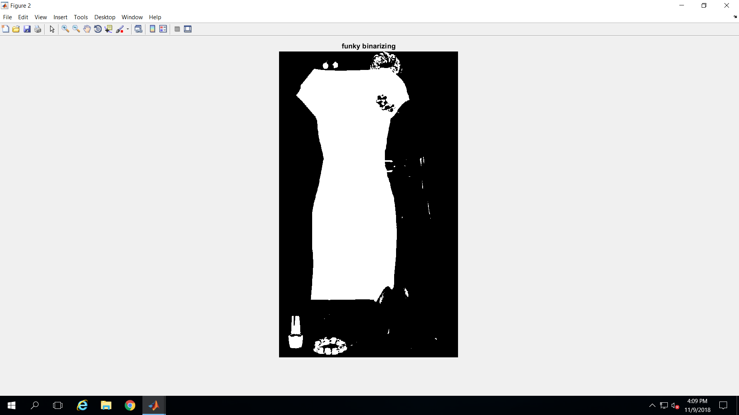
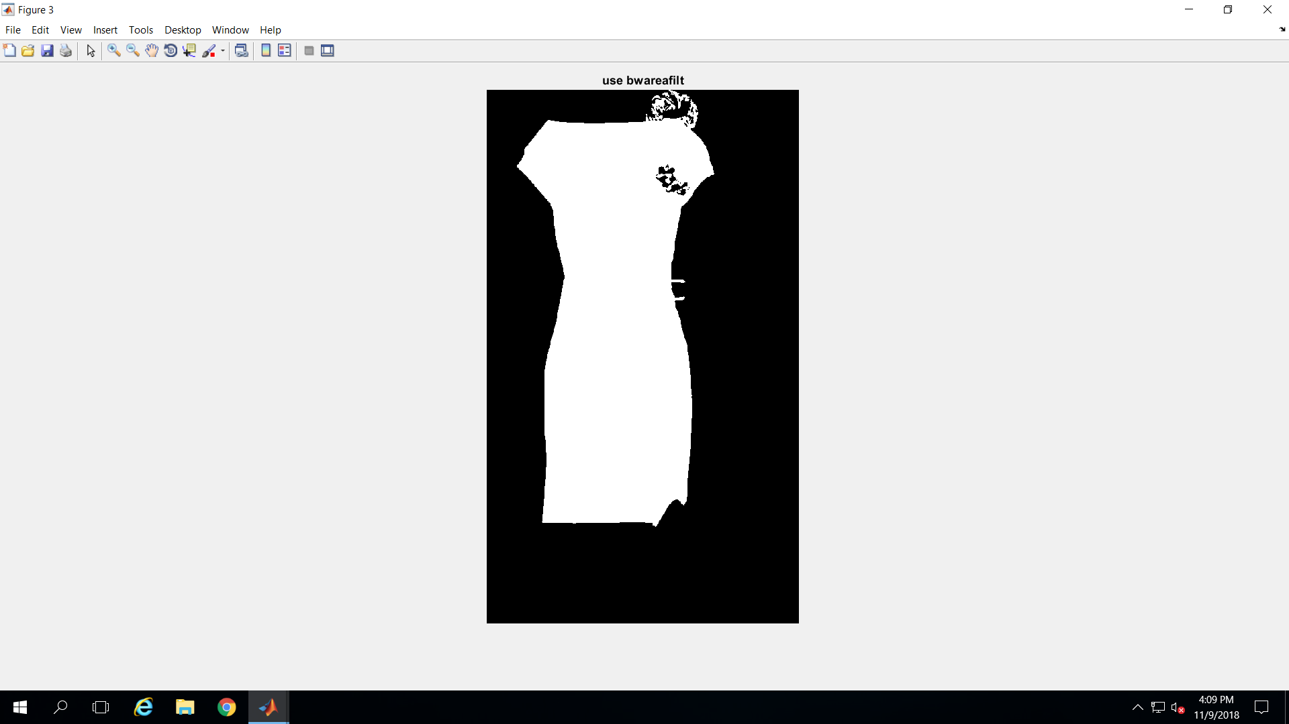
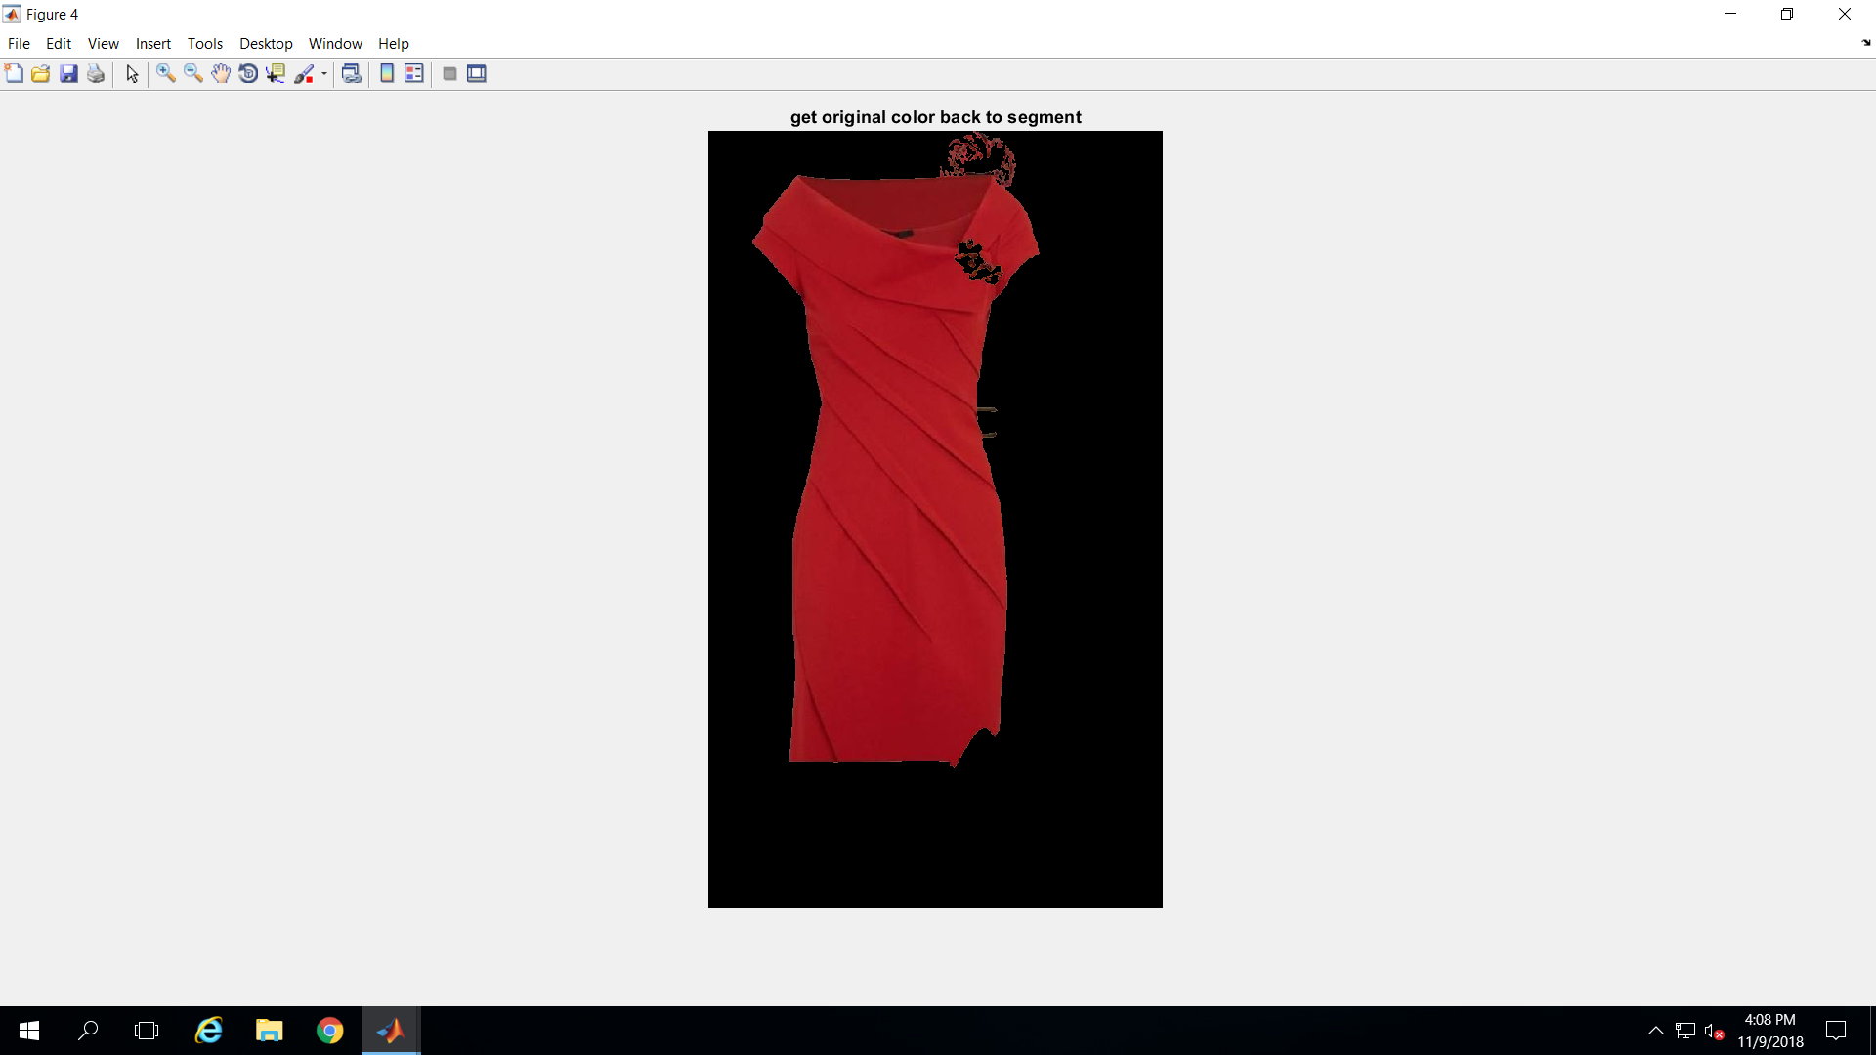
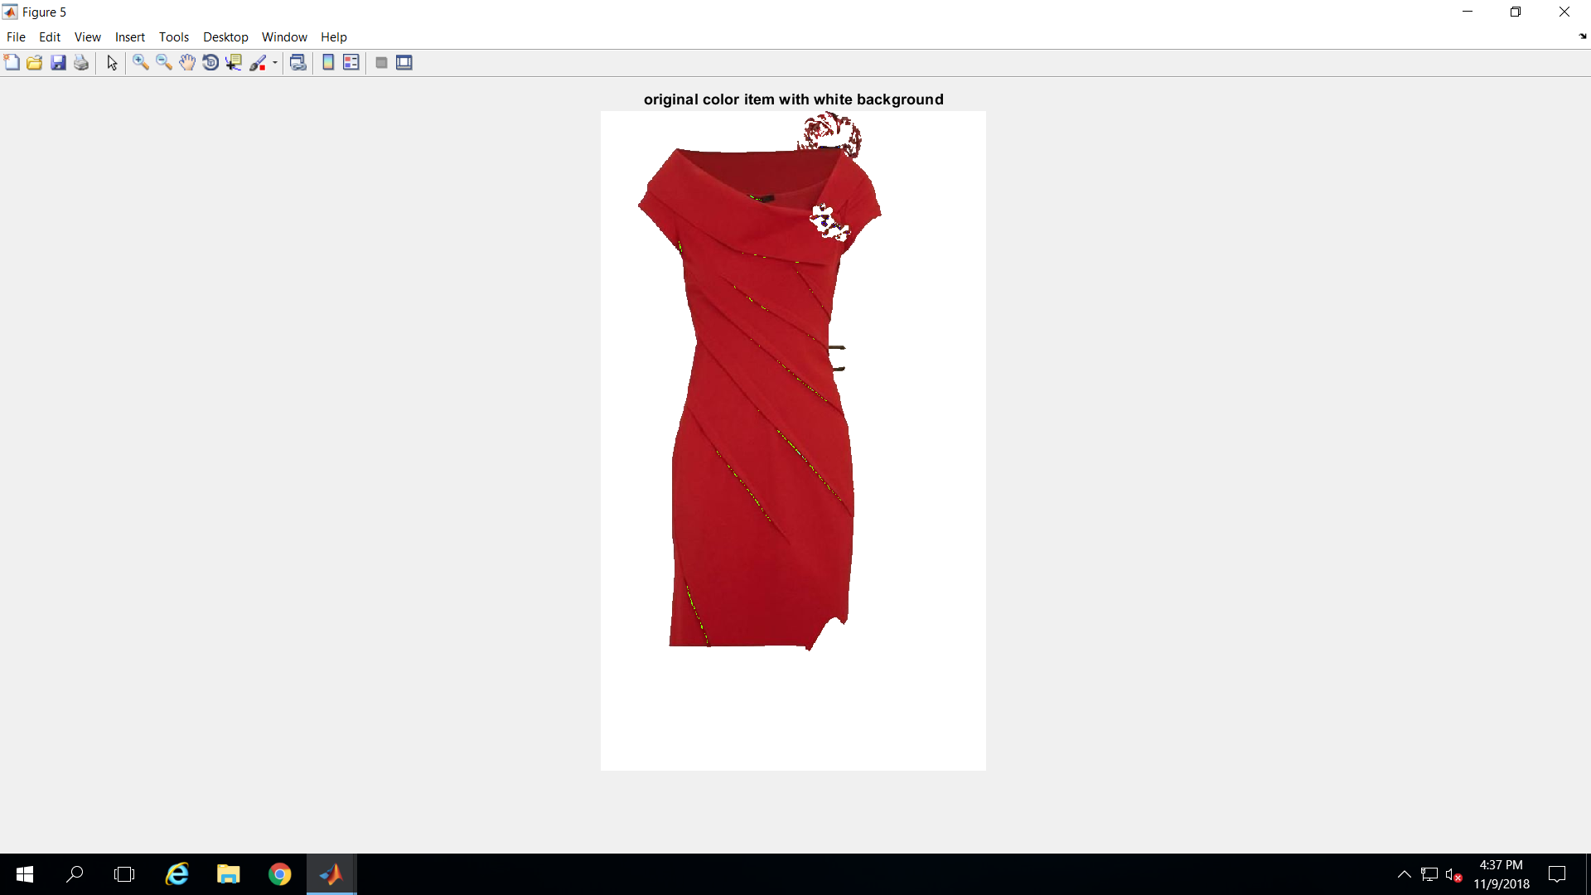
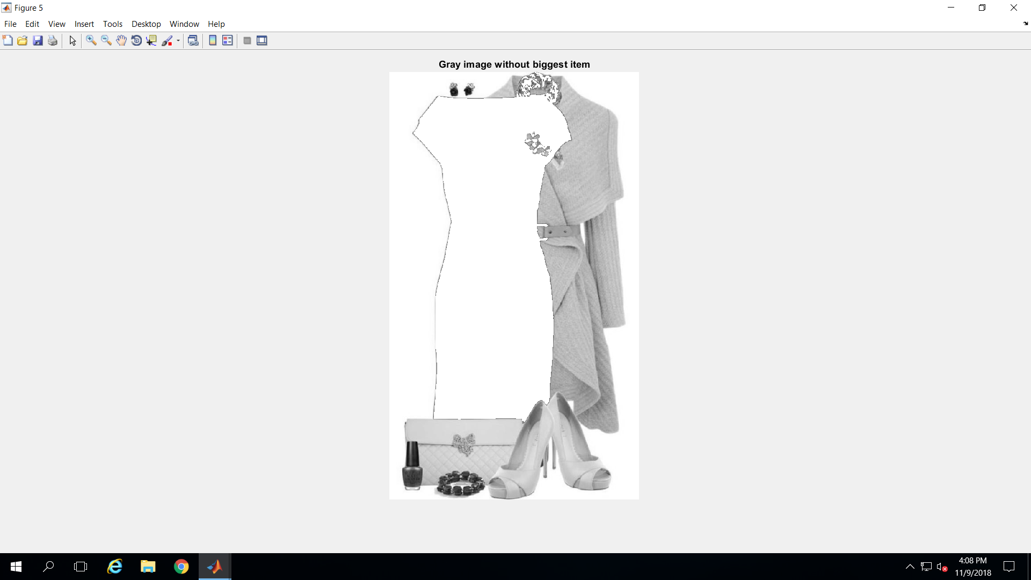
results: pass #1
1) original 2) grayscale 3) binarized 4) ‘bwareafilt’-ized 5) mask*orig 6) backgr 2 white 7) orig minus item

Slide 19
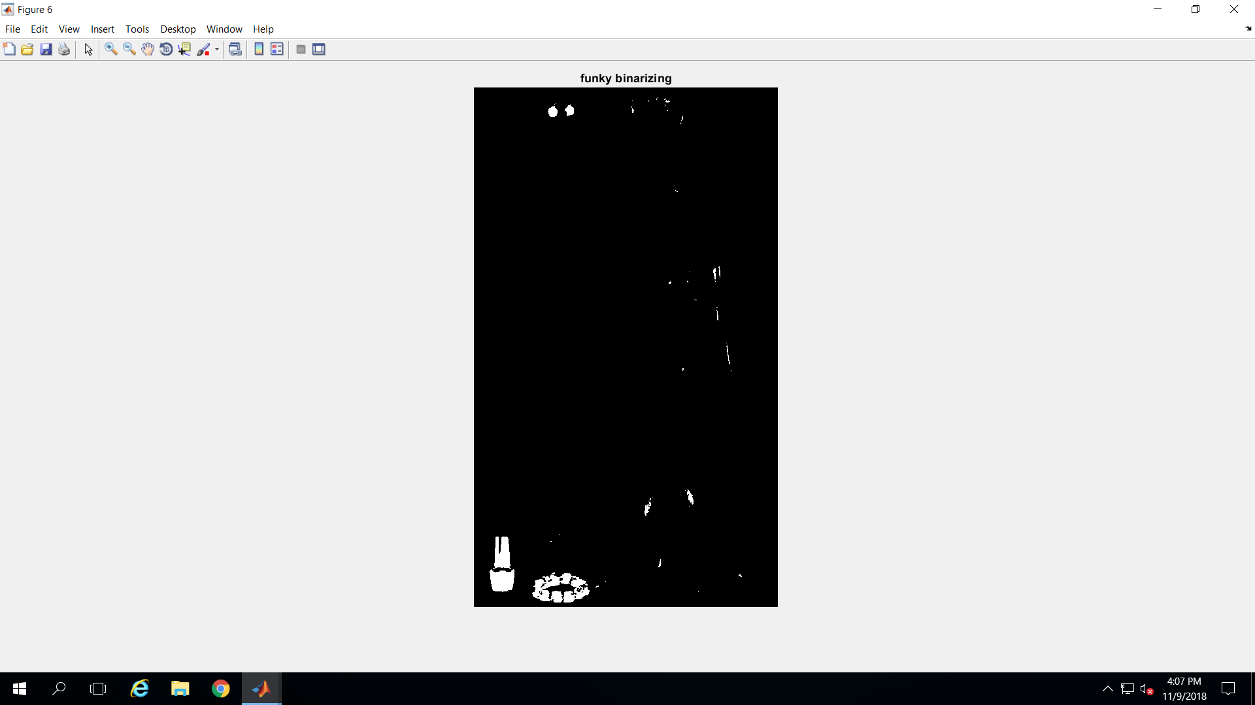
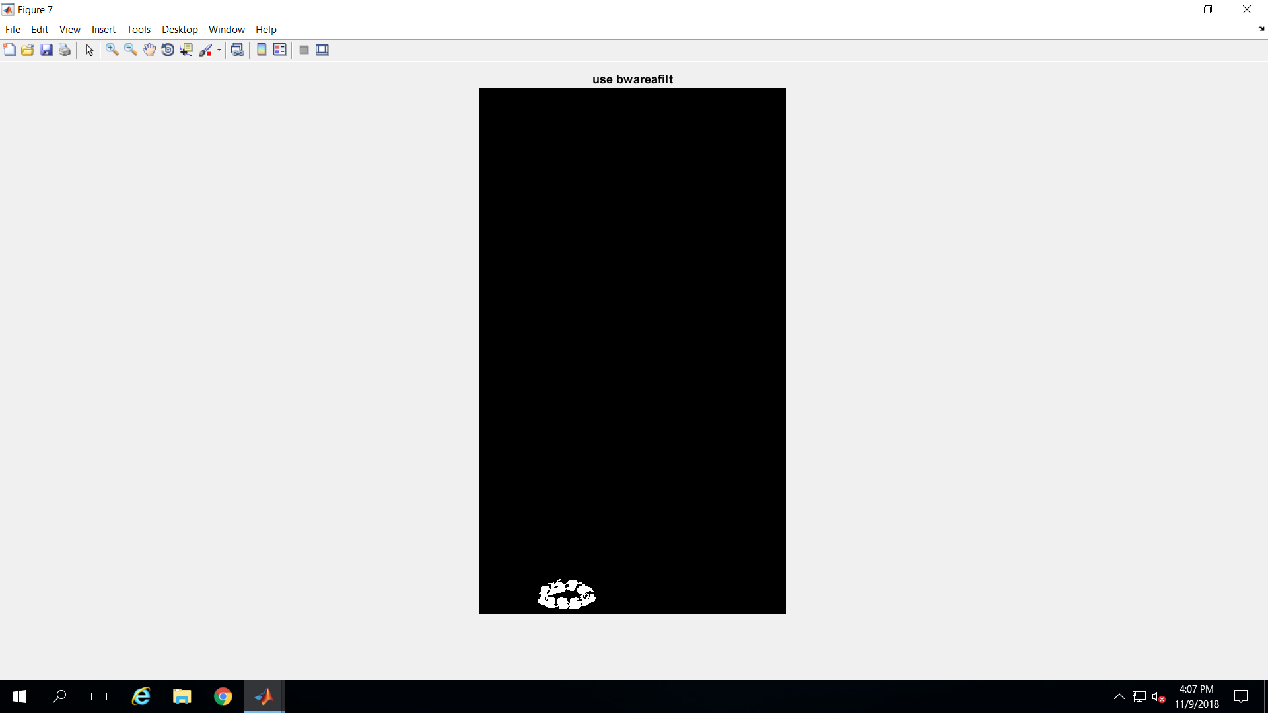
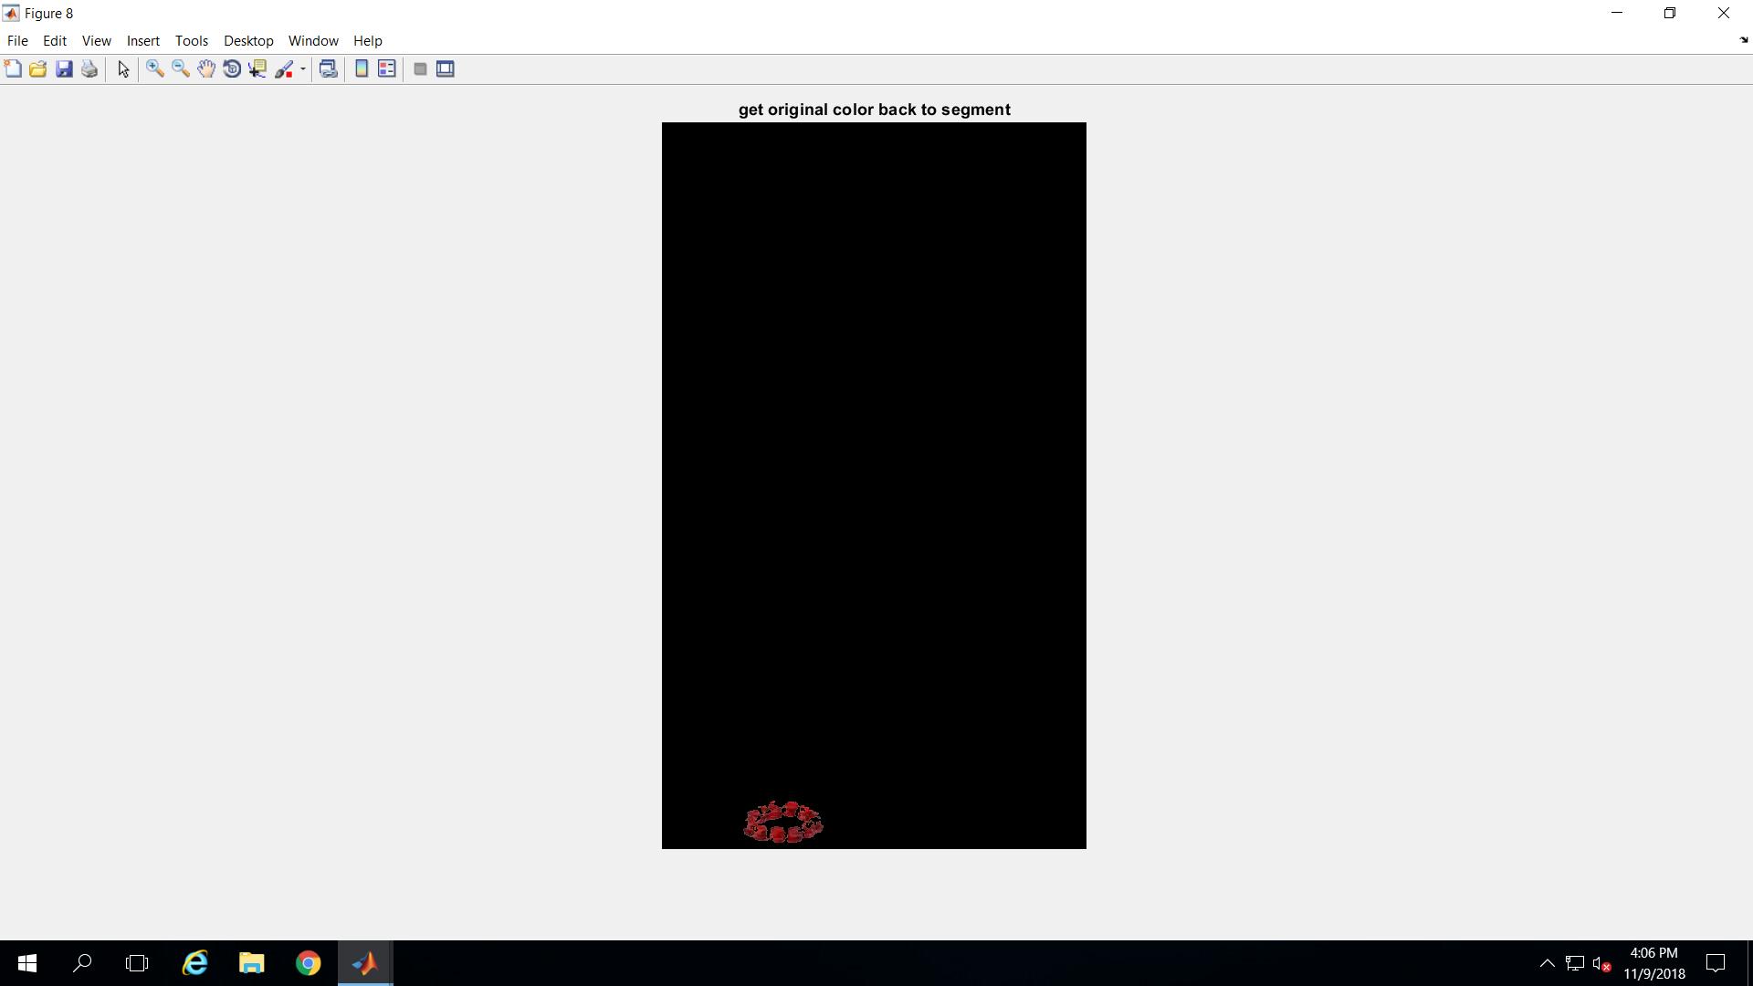
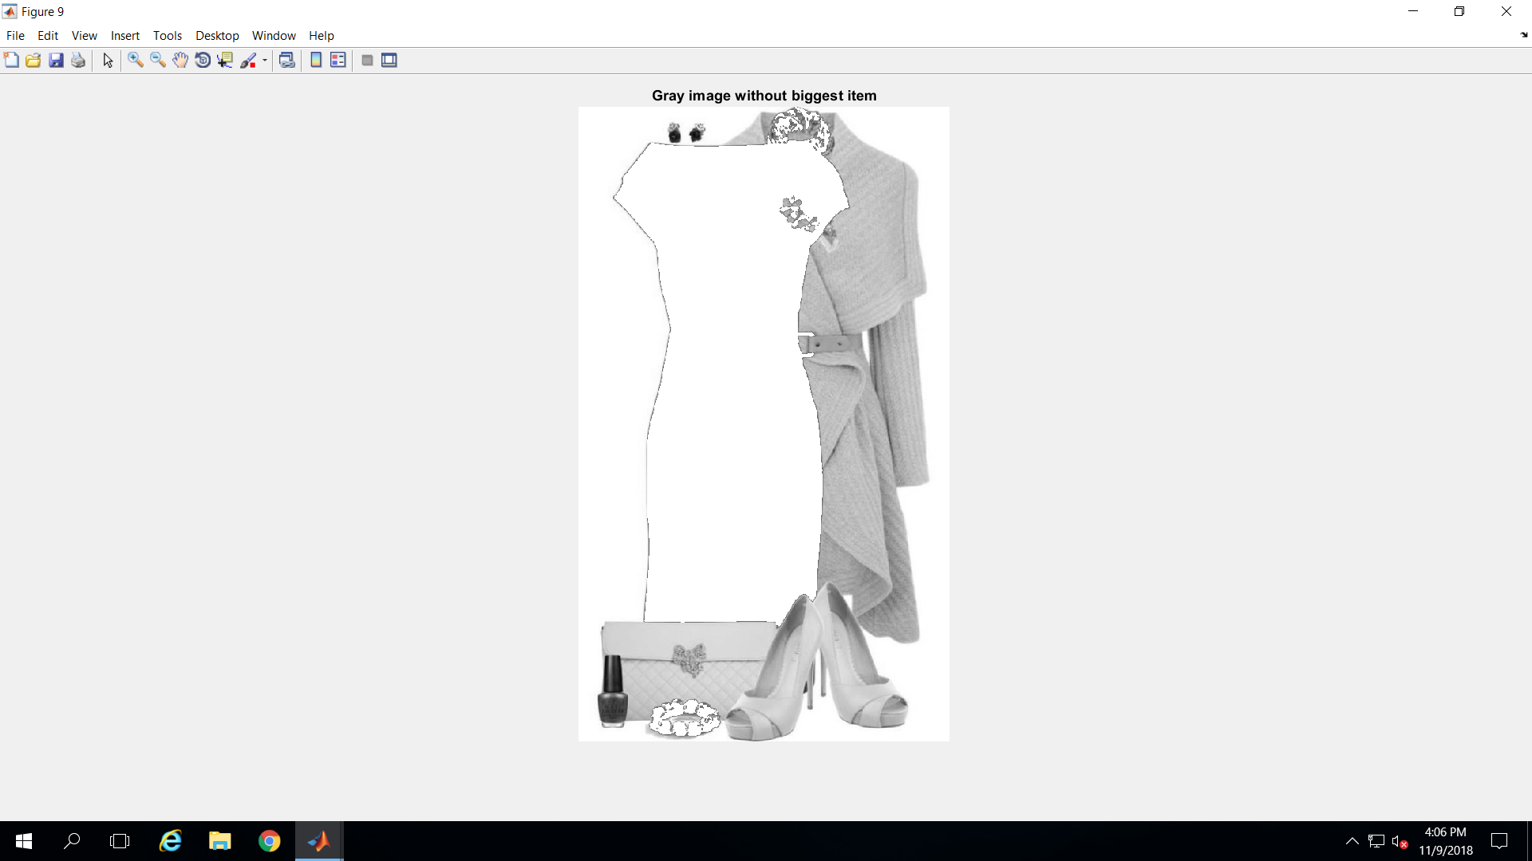
results: pass #2
1) grays after pass #1 2) binarized 3 ) ‘bwareafilt’-ized 4) mask*orig 5 ) backgr 2 white 6 ) orig minus item
Note: binarizing wipes out the sweater, shoes and purse.
I tried ‘reverse’ binary transformation, but that didn’t help. I could never get the sweater, shoes and purse.

Slide 20
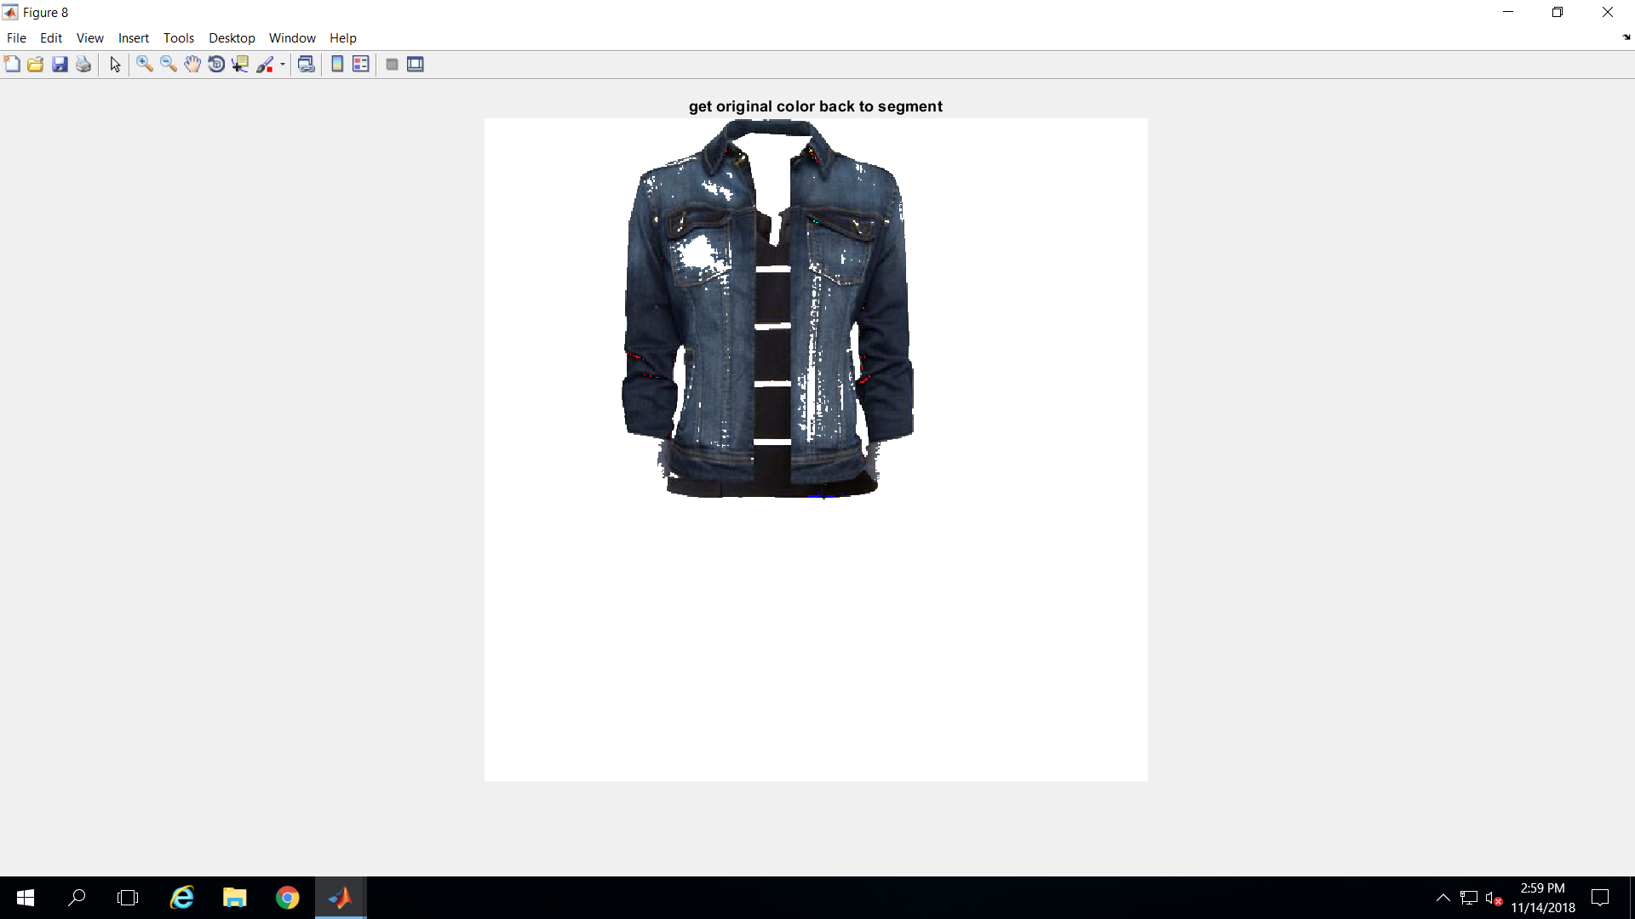
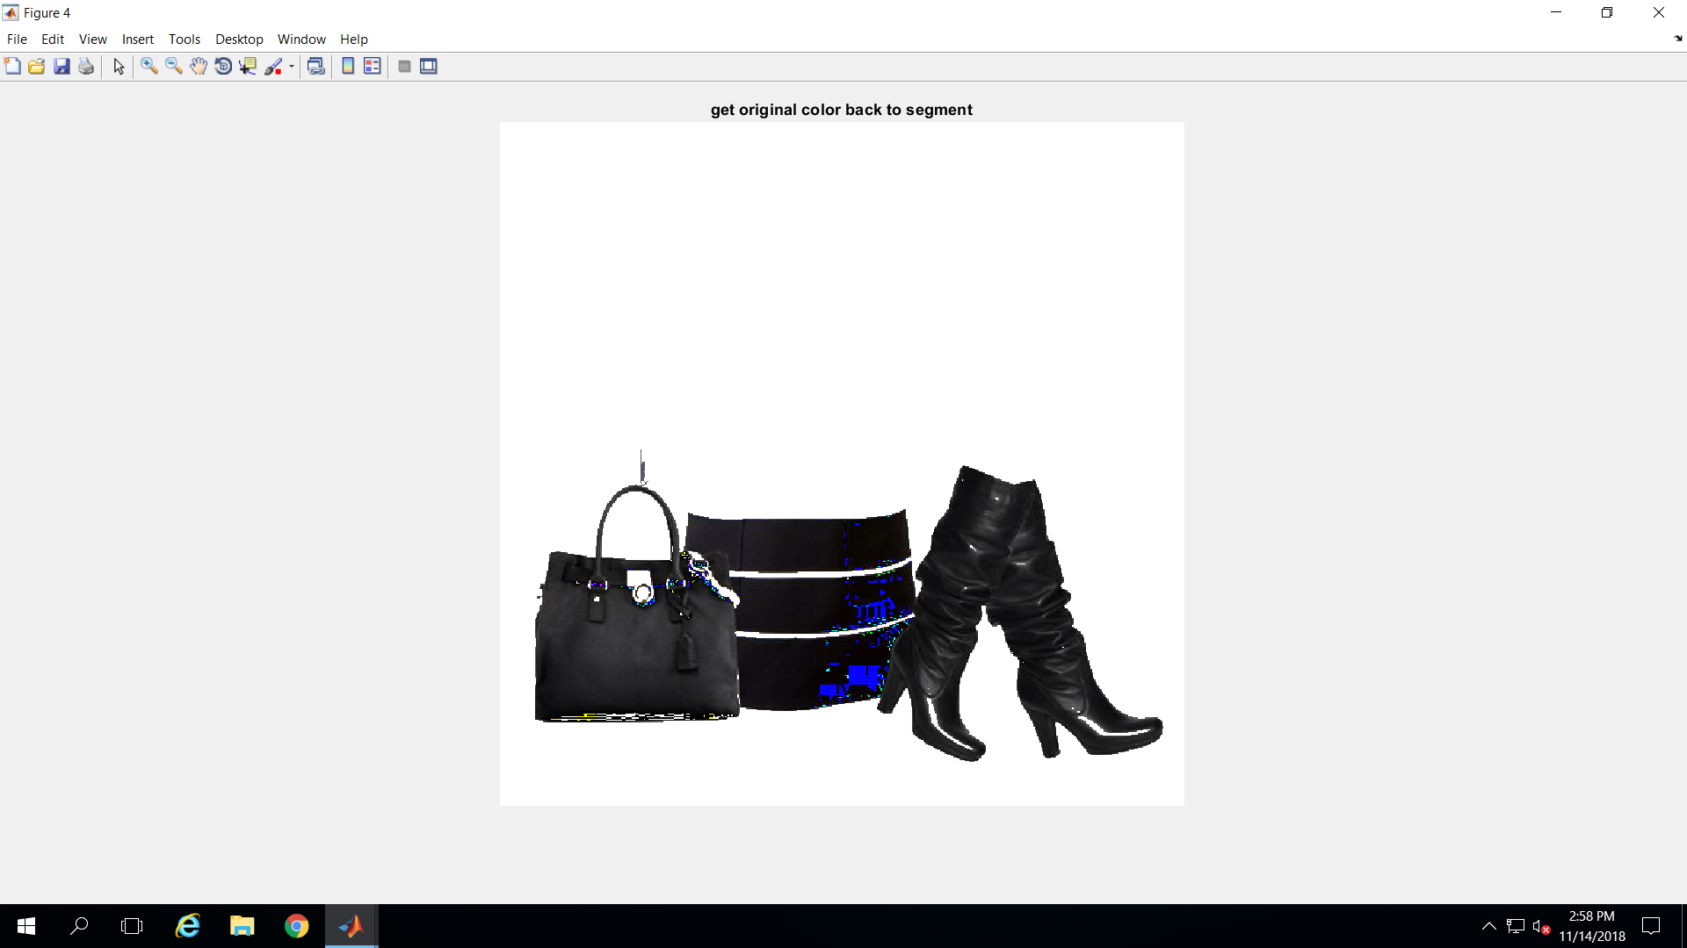
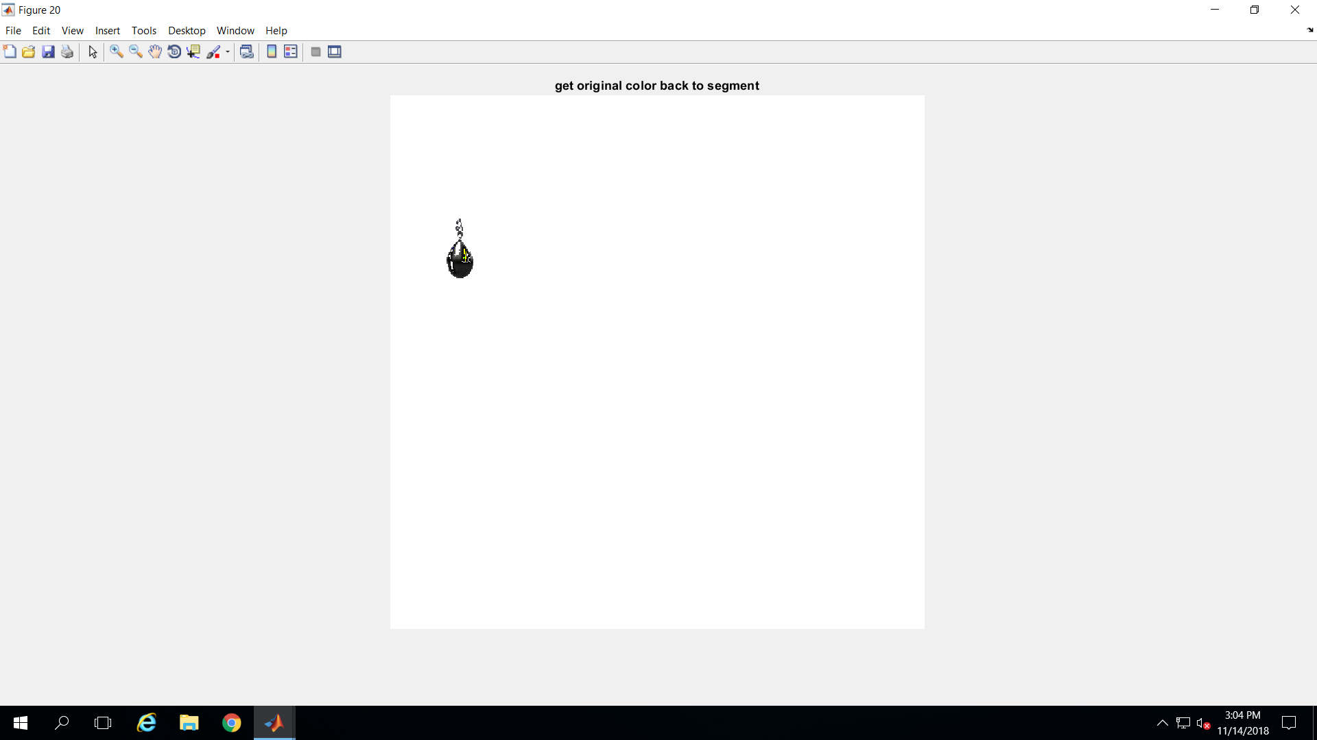
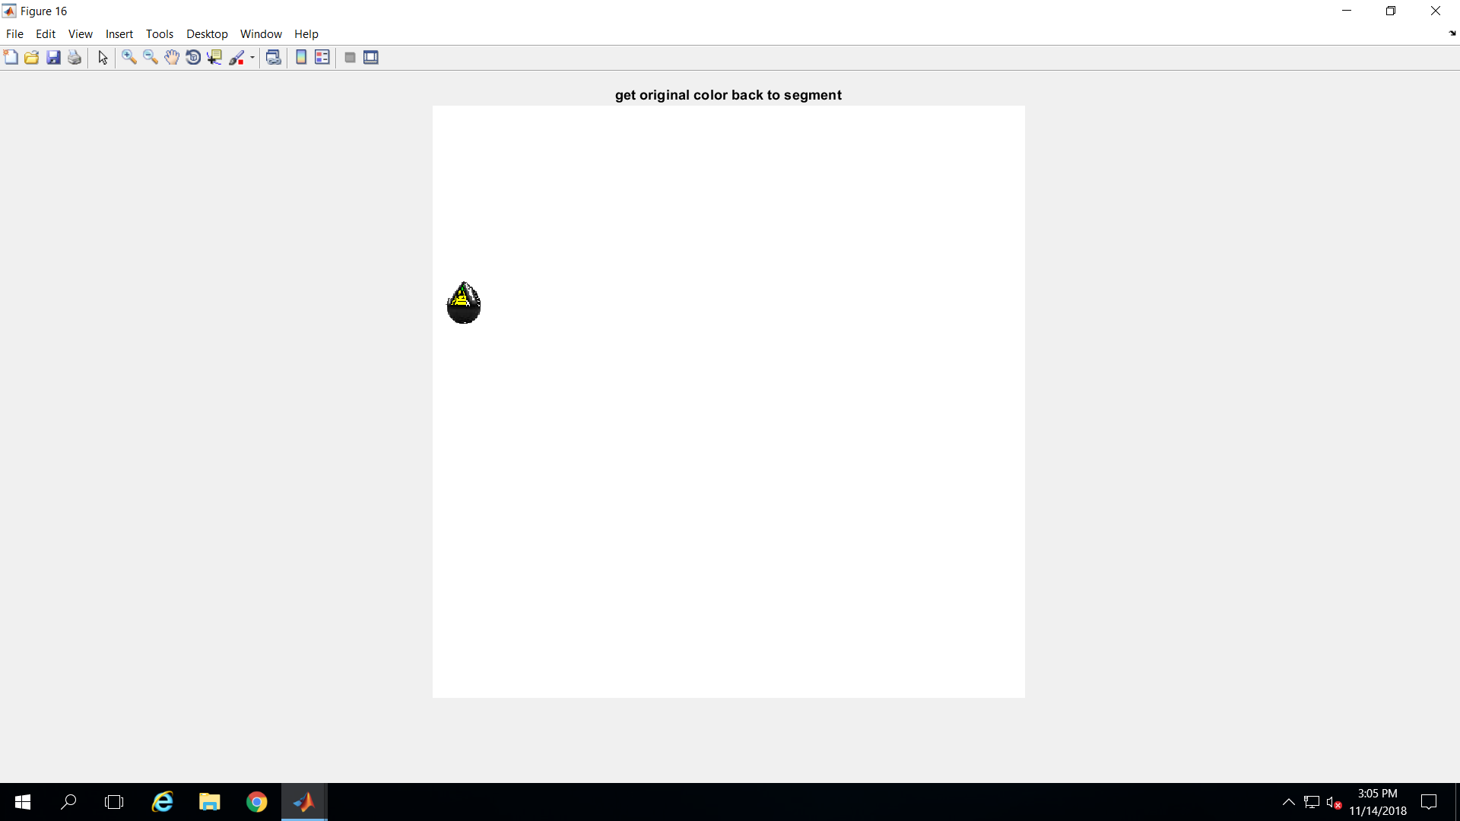
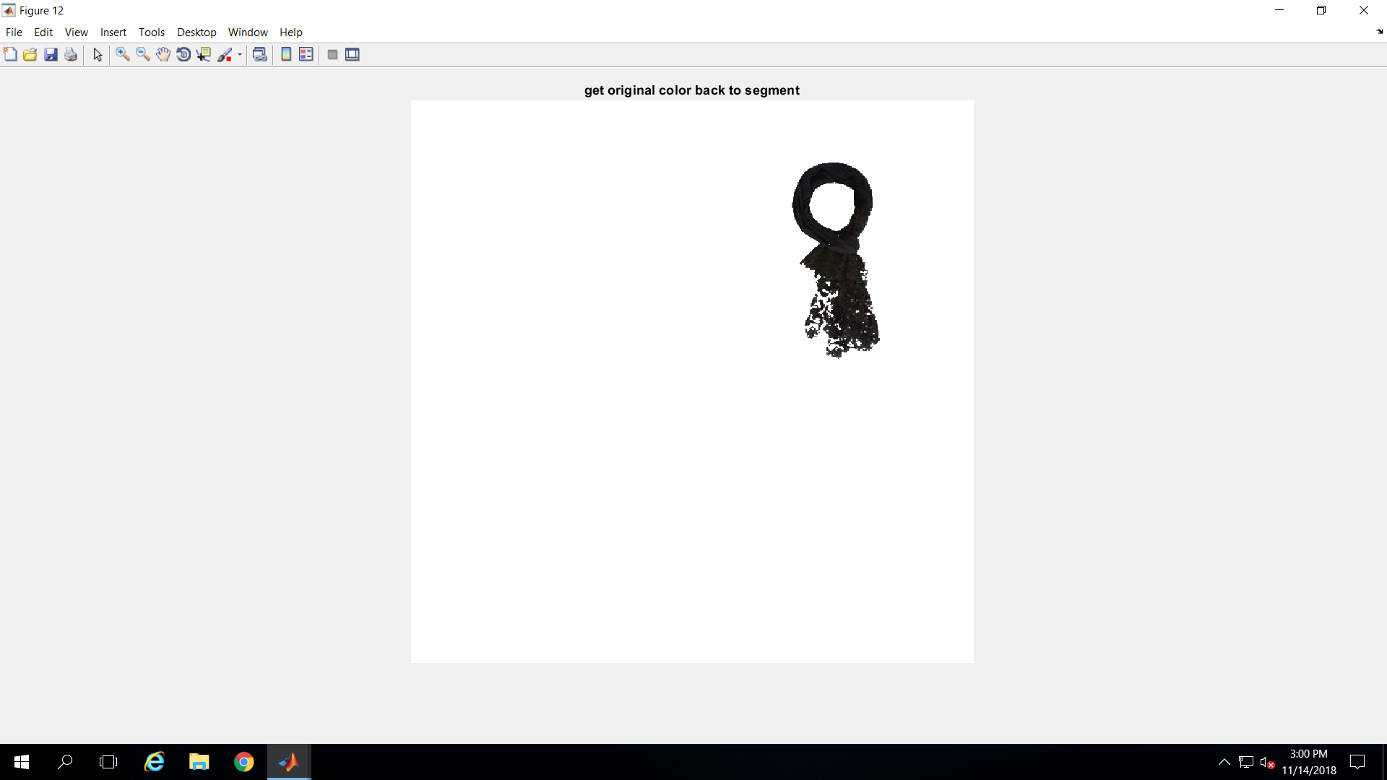
results

Slide 21
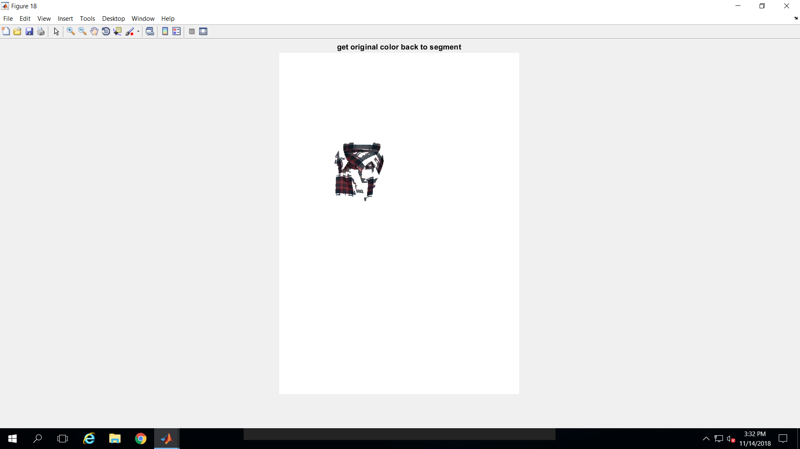
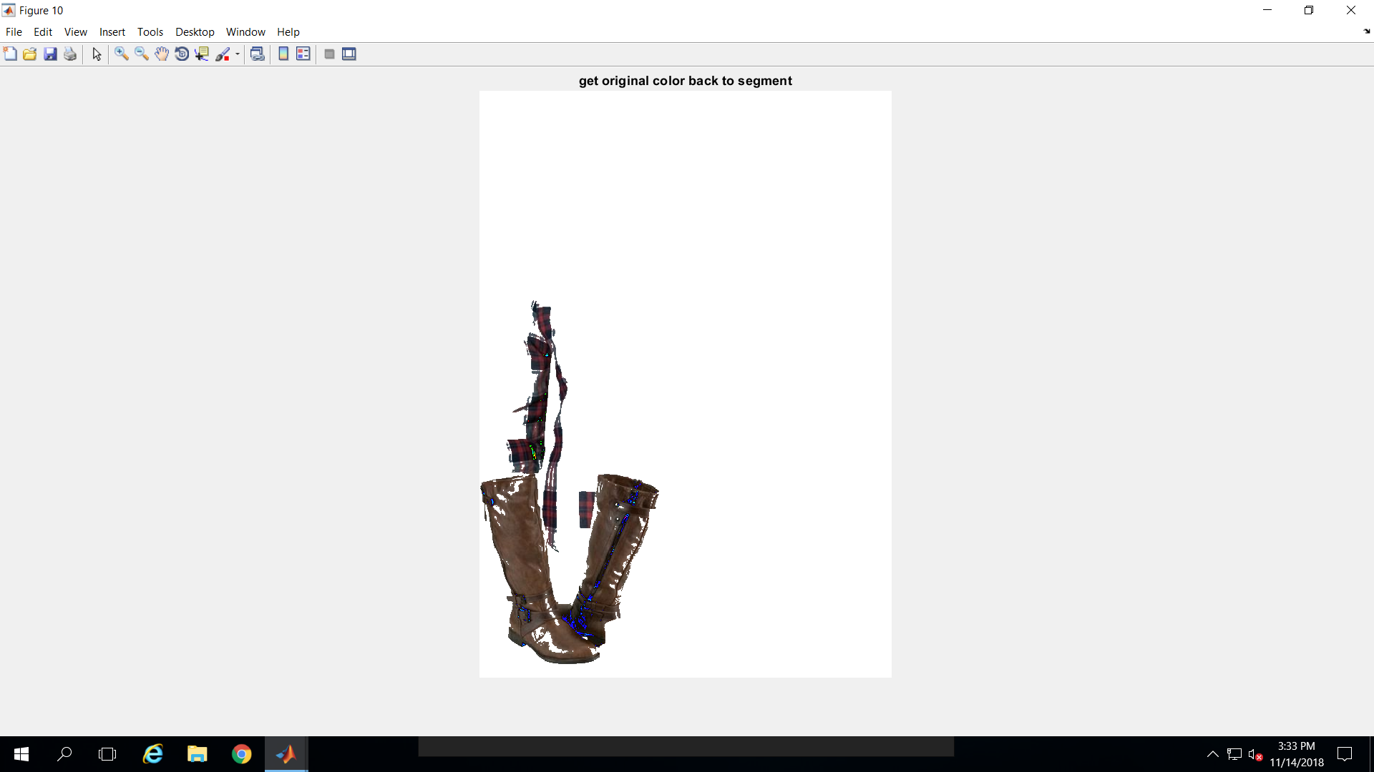
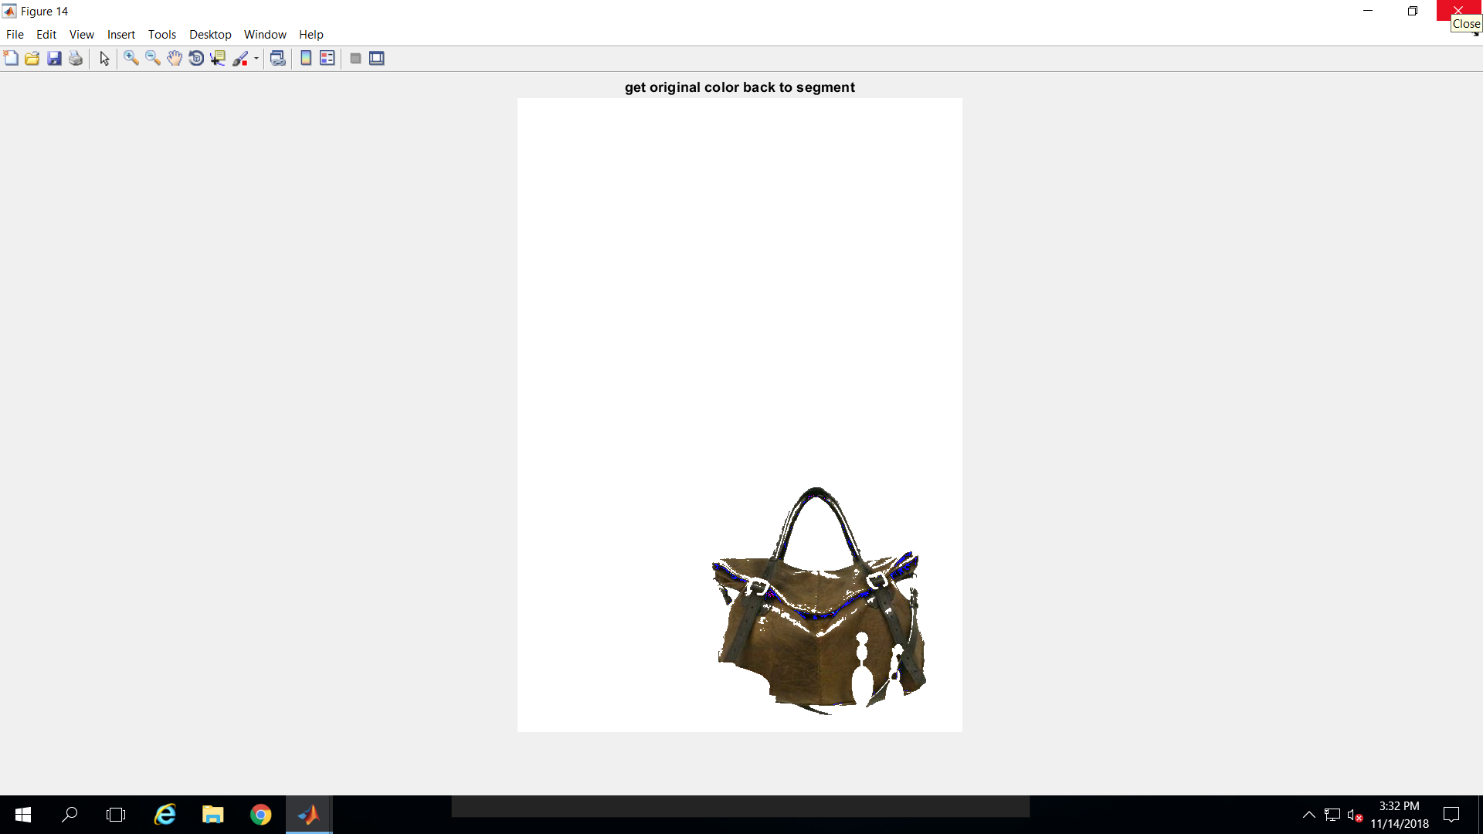
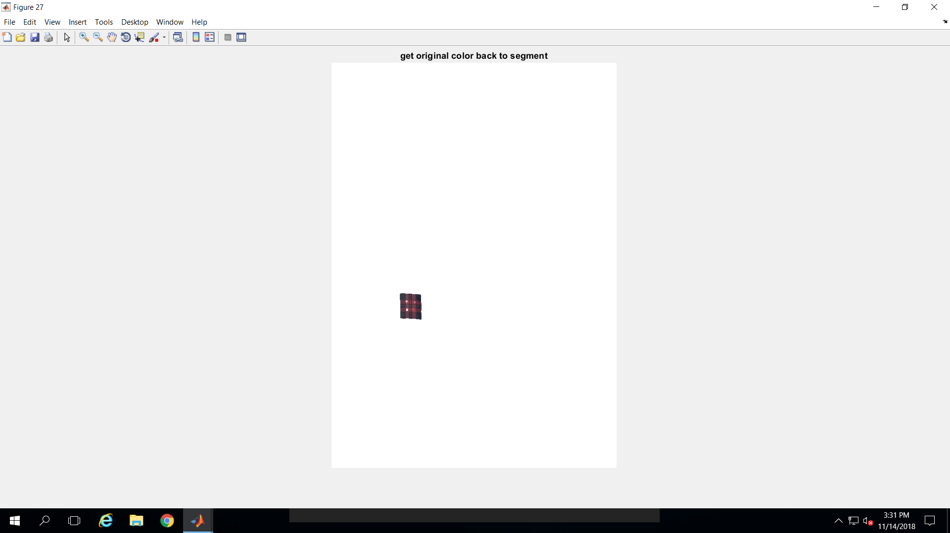
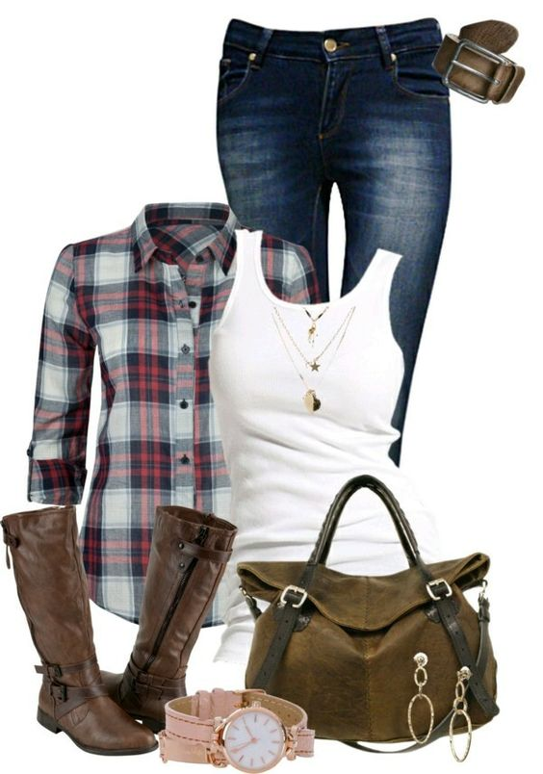
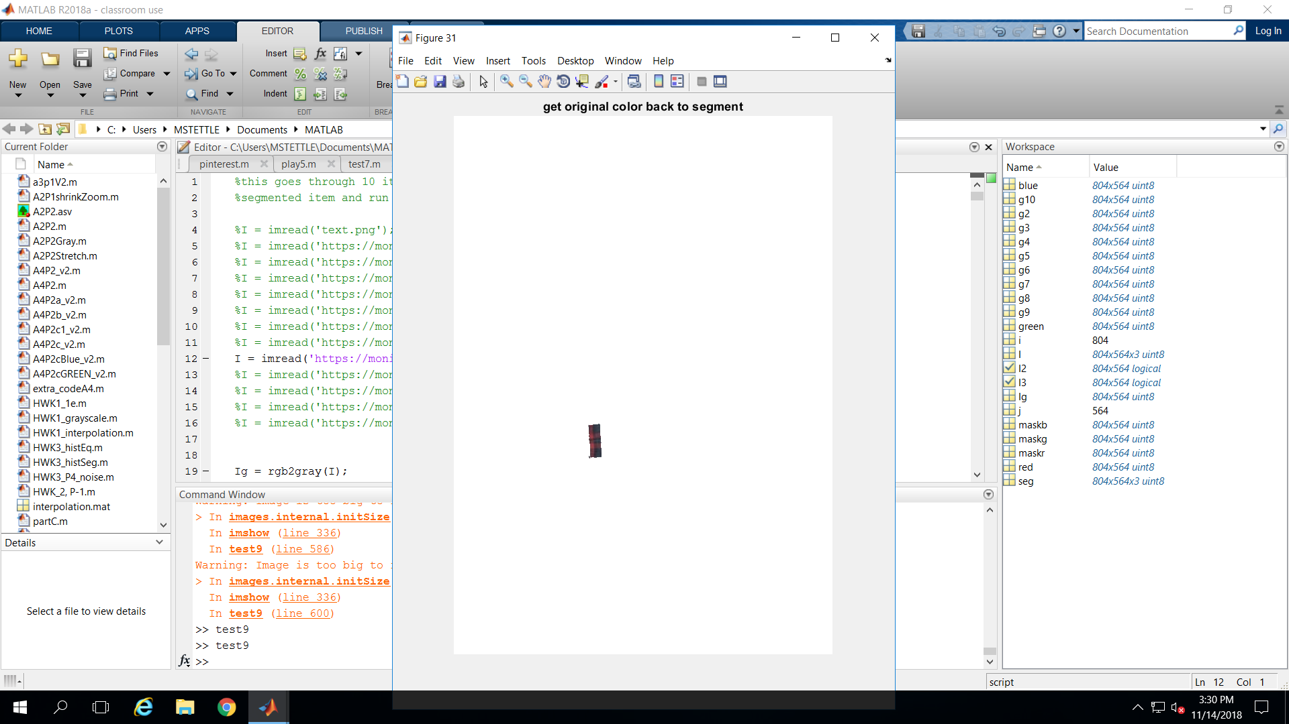
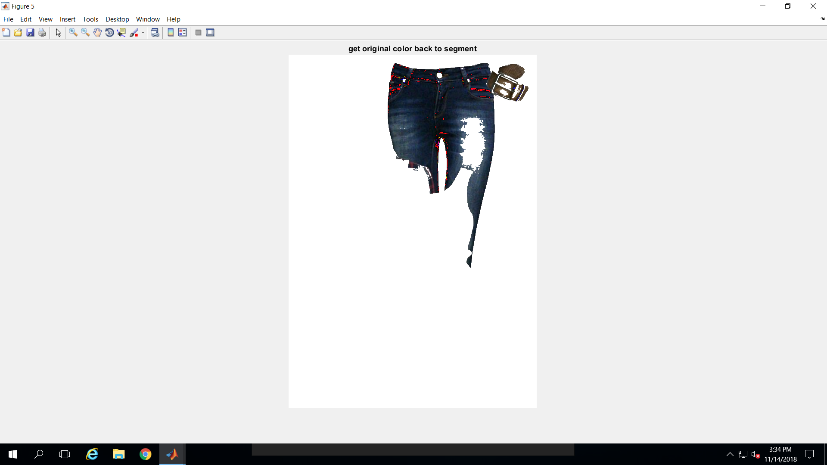
results

Slide 22
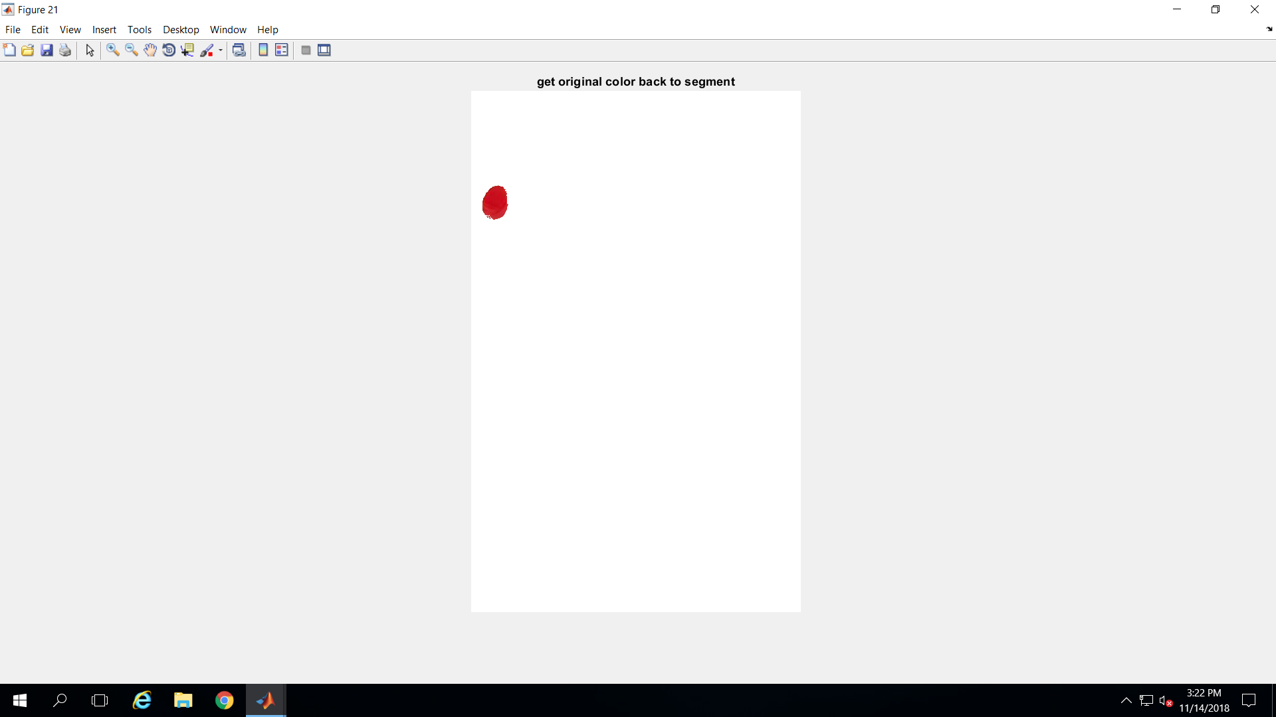
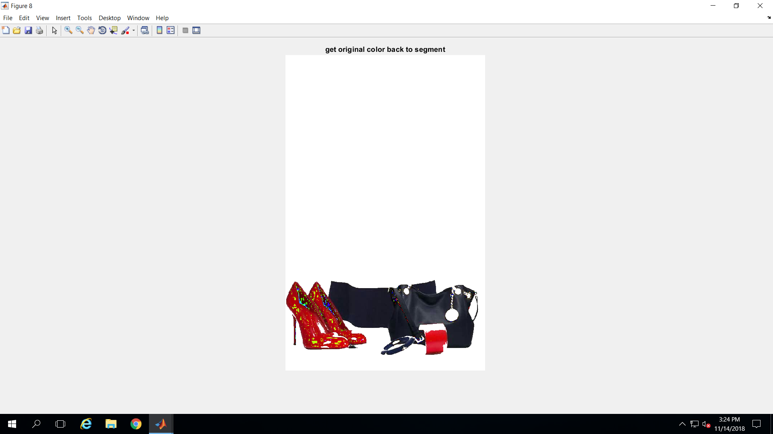
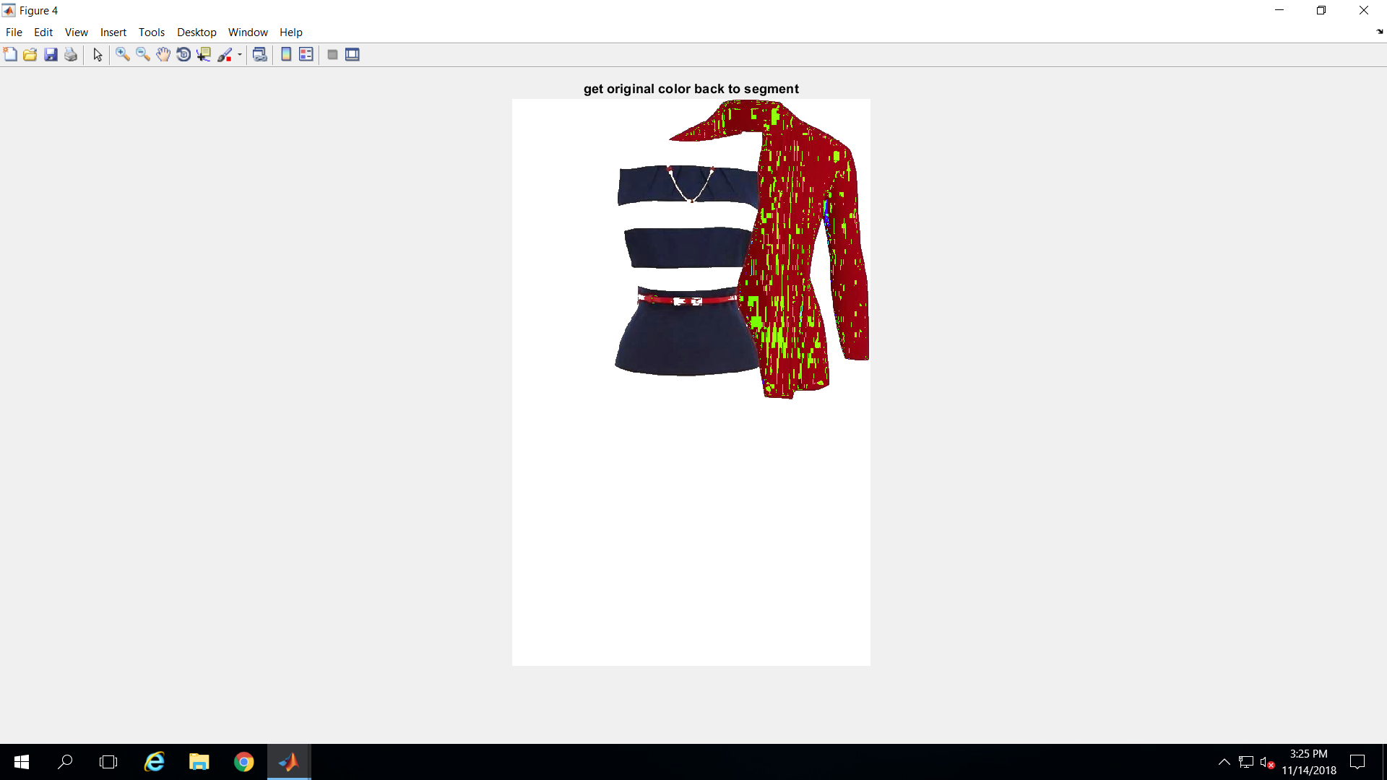
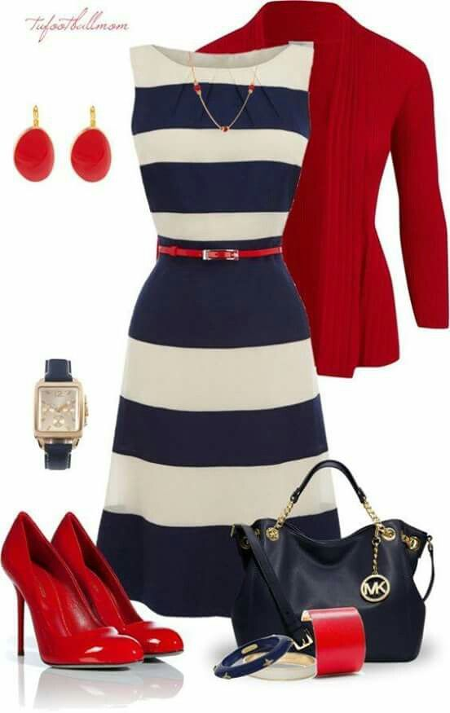
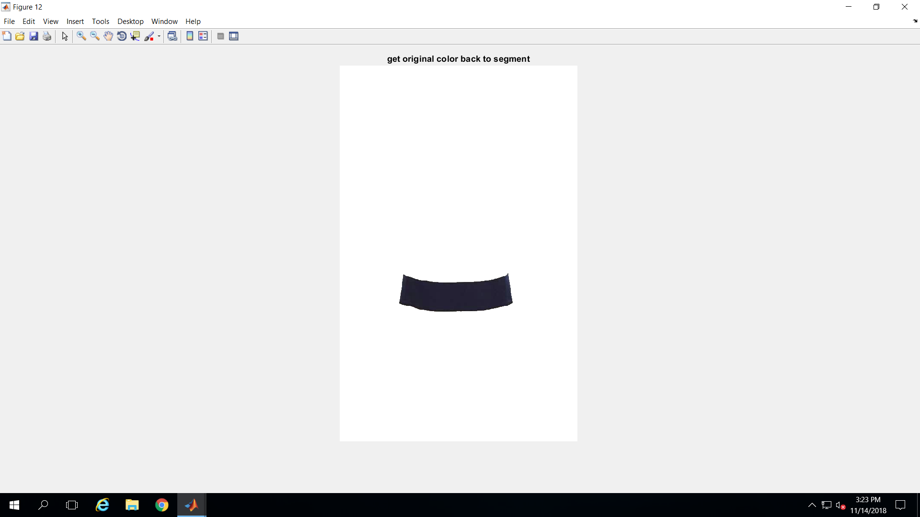
results

Slide 23
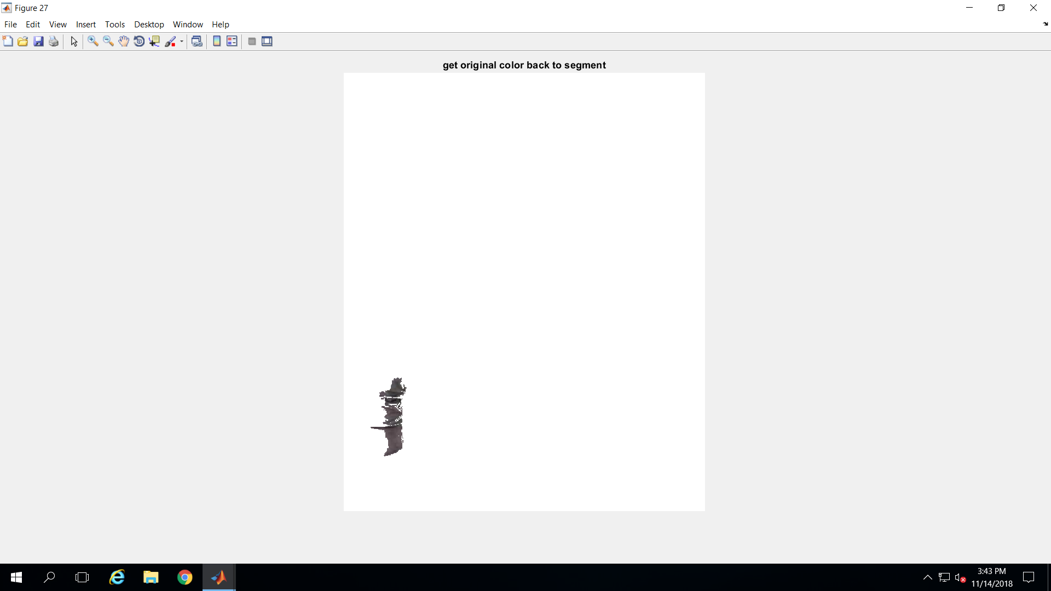
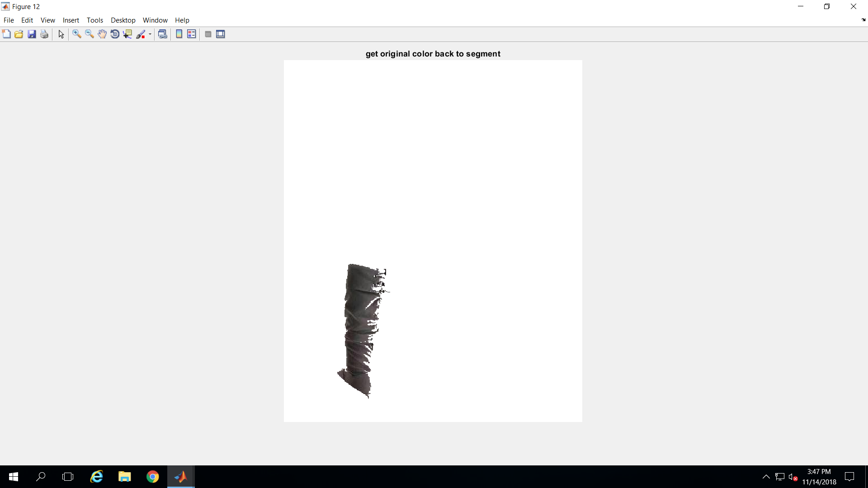
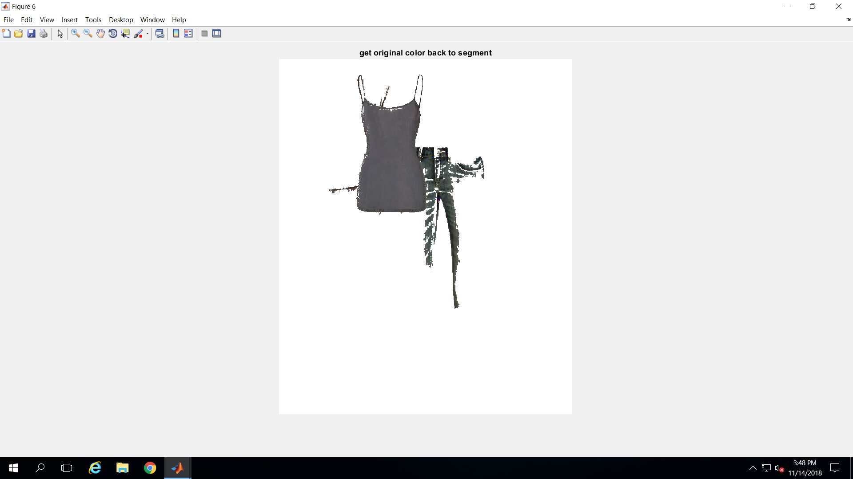
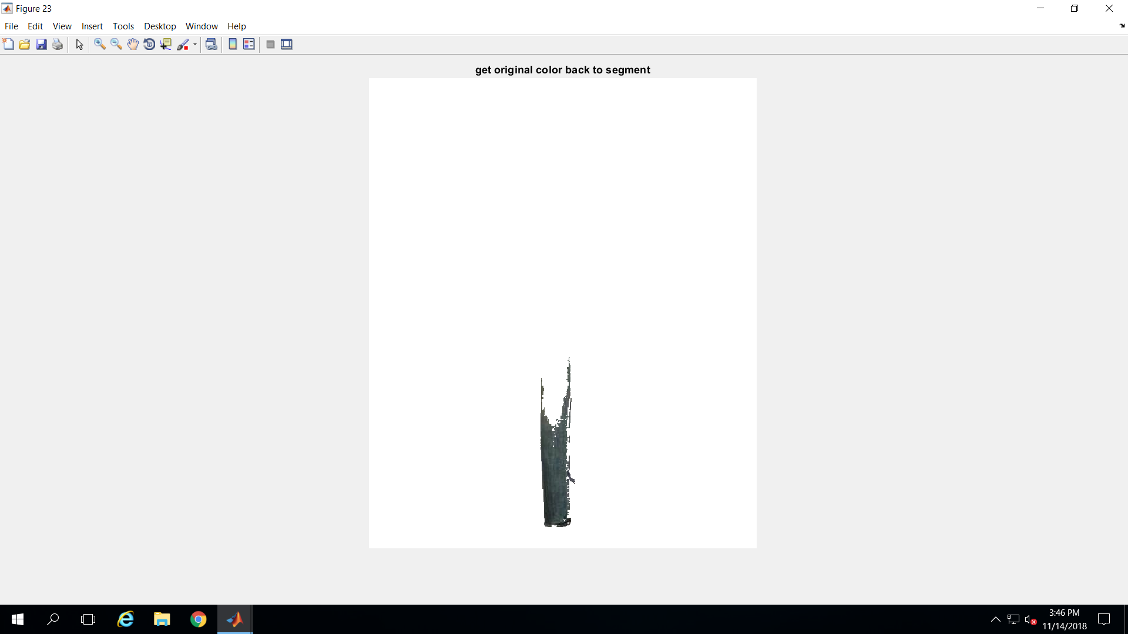
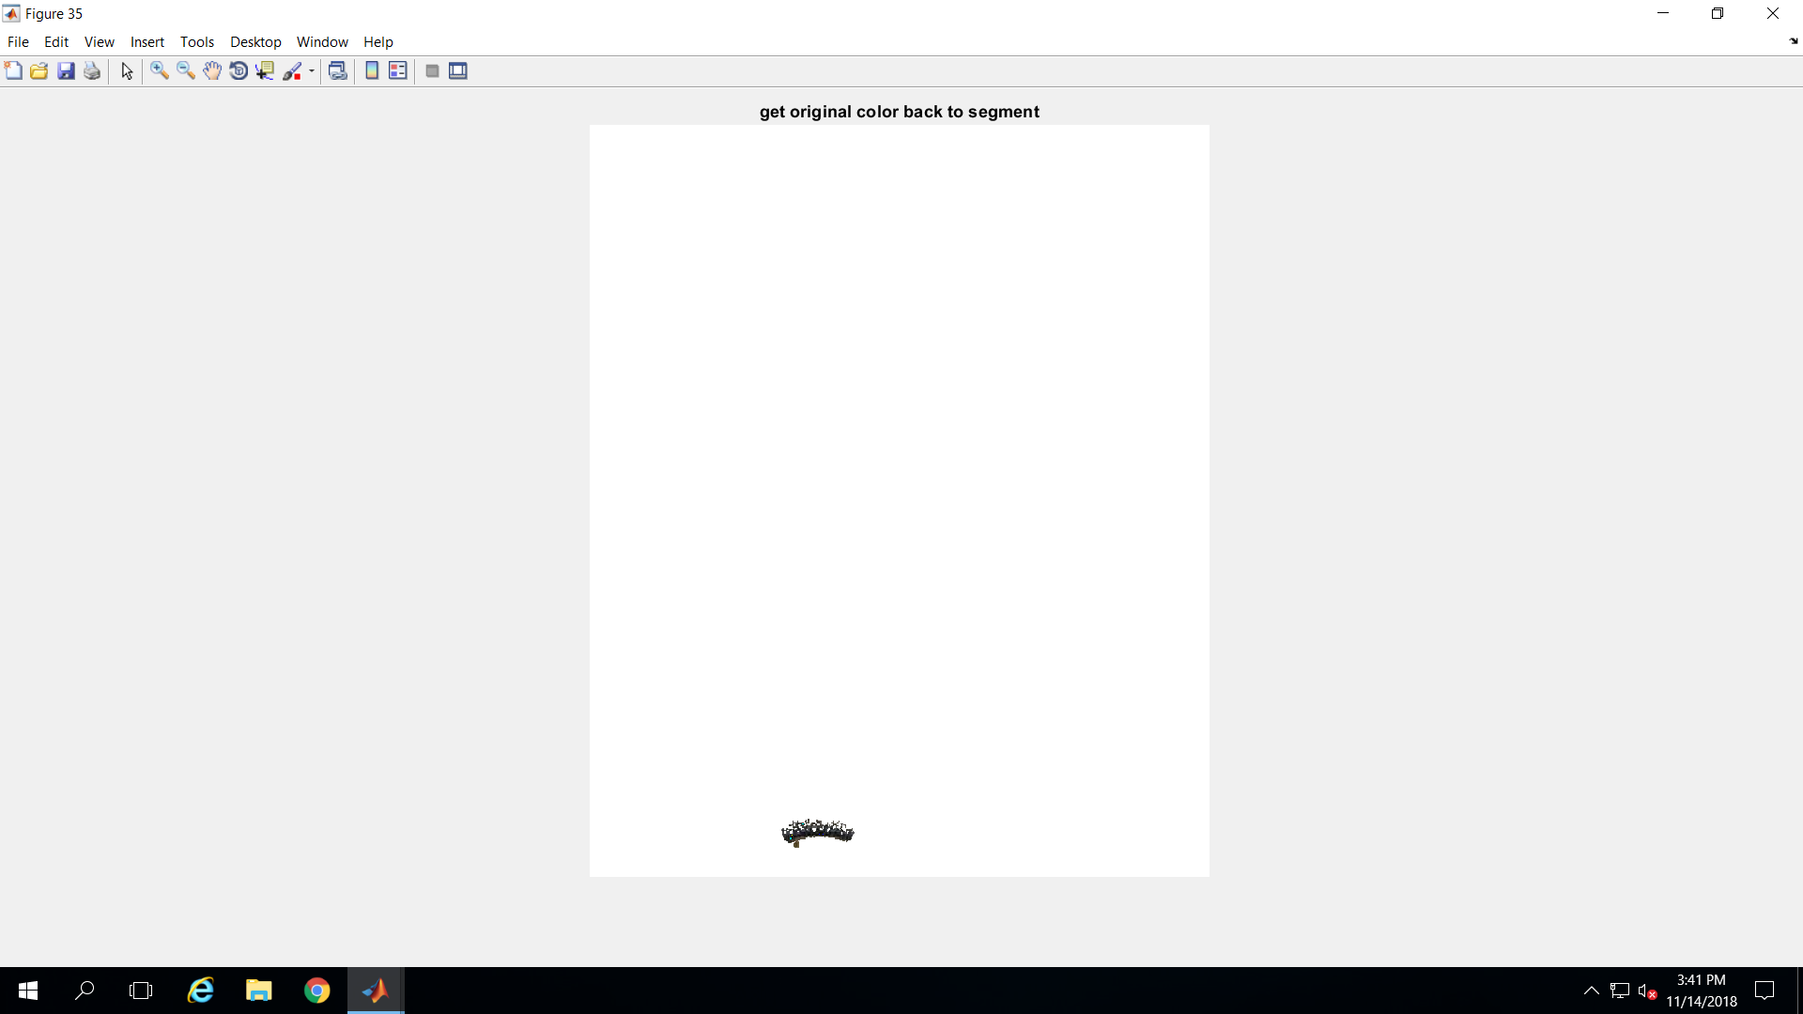
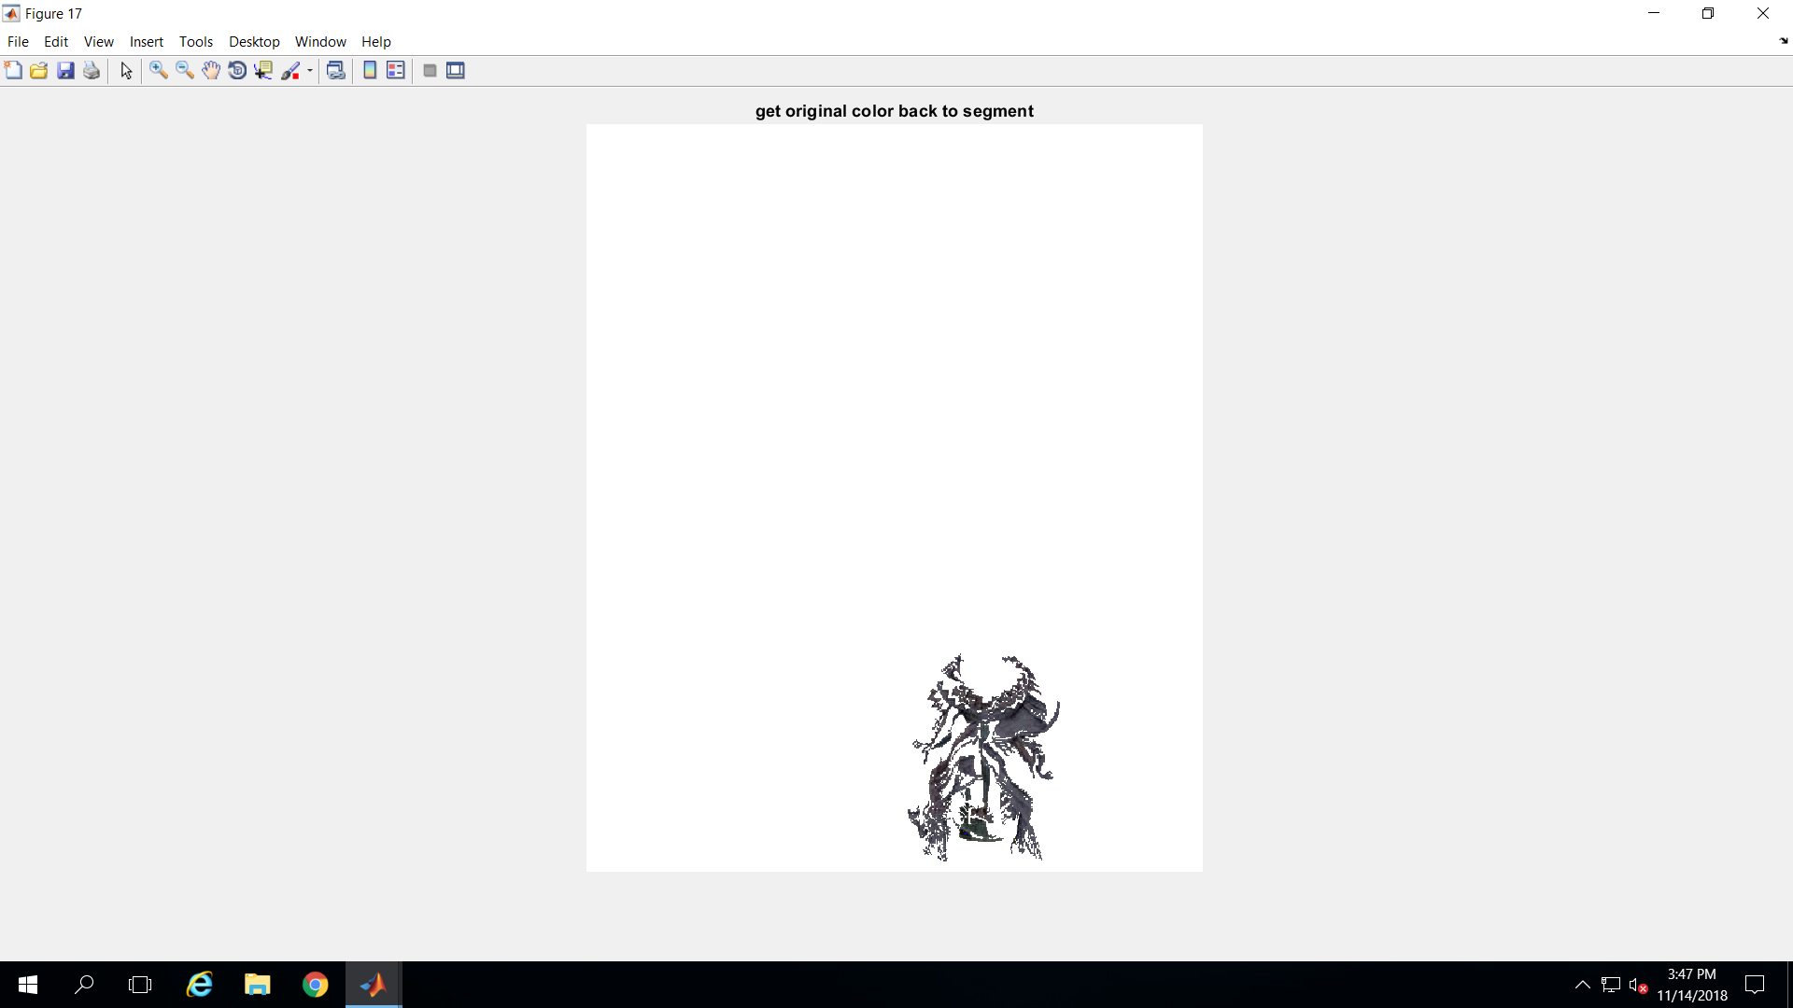
results

Slide 24
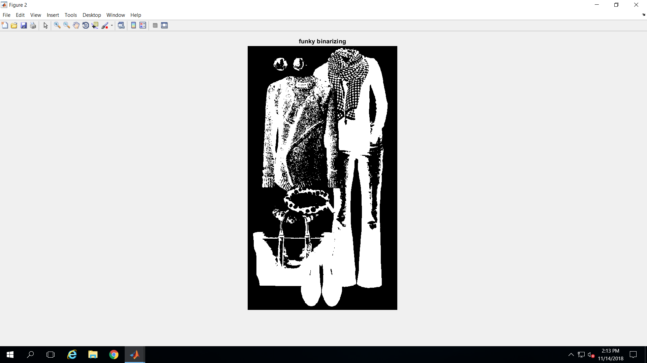
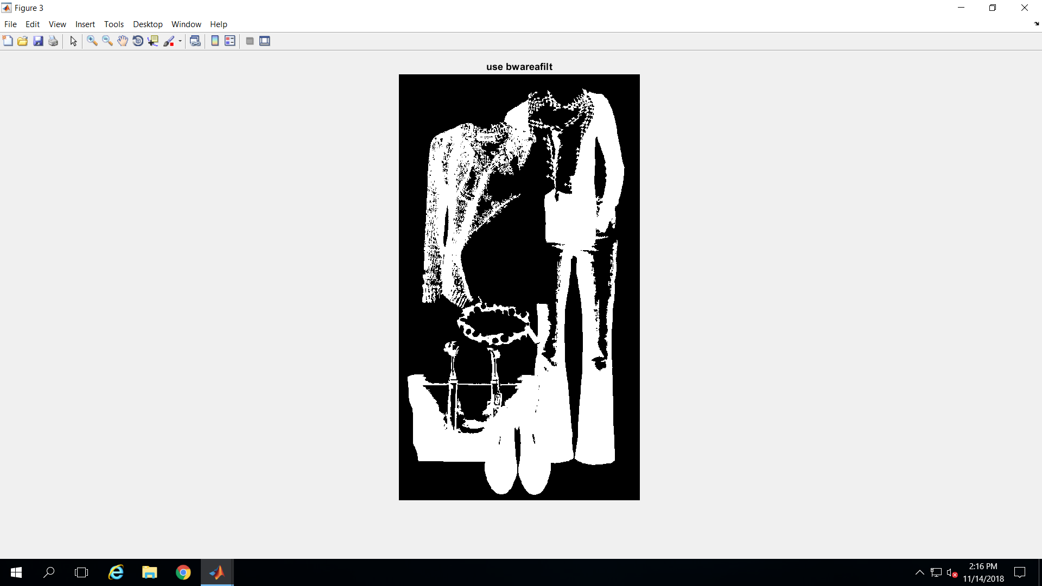
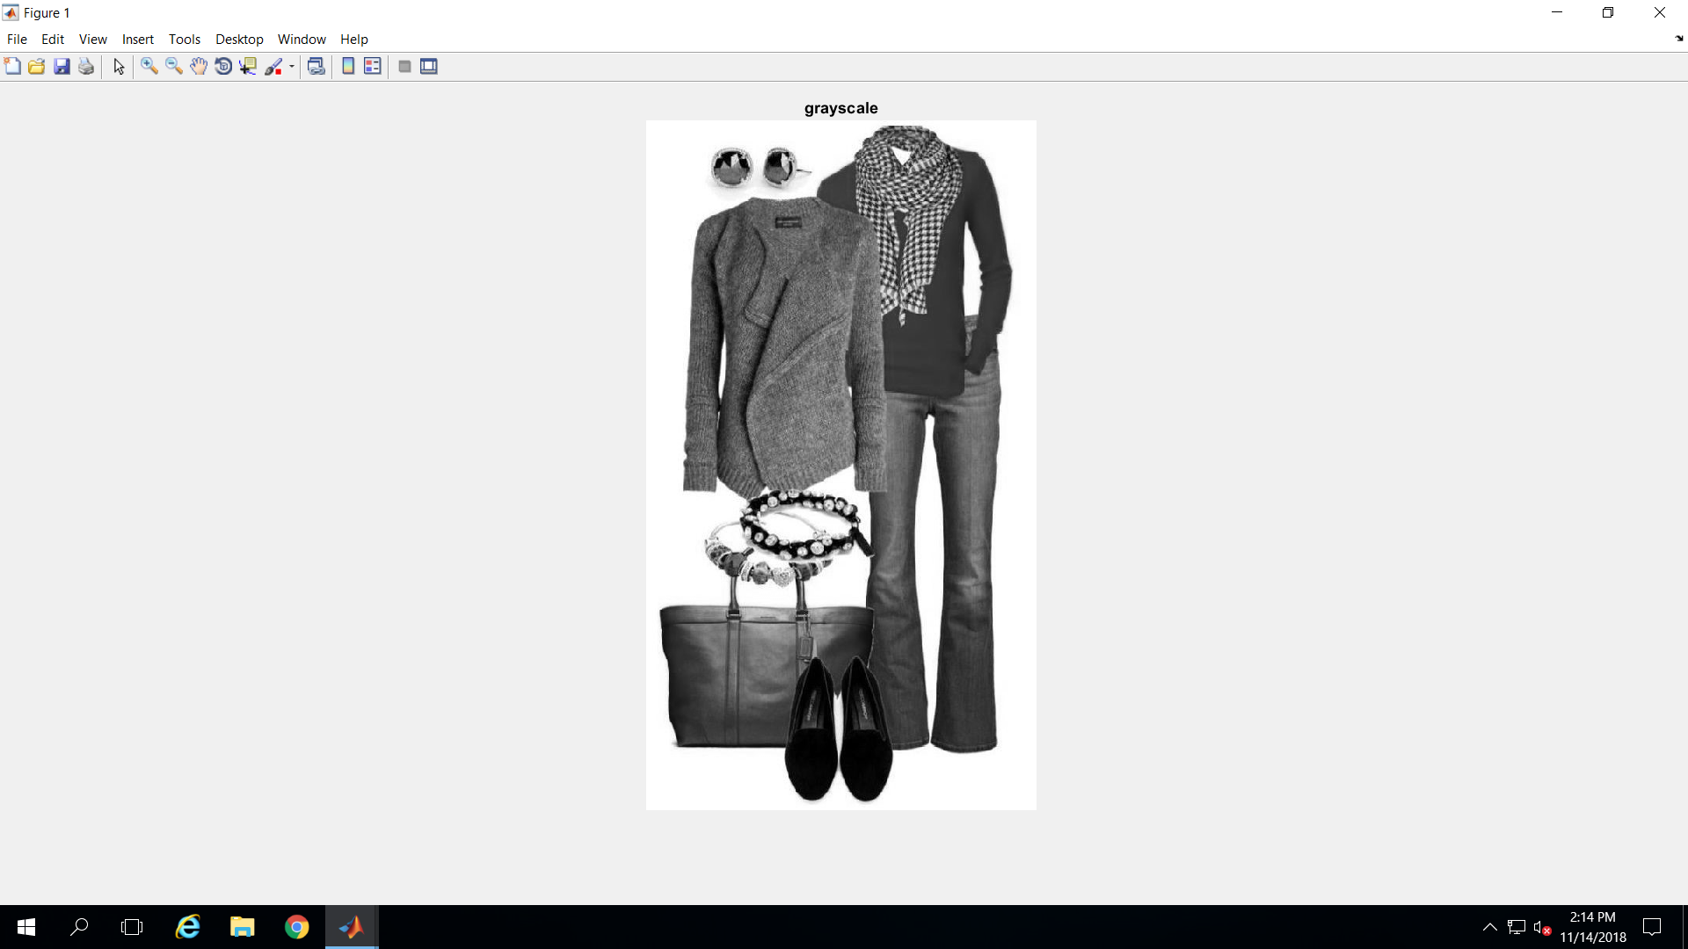
fail
1) Original 2) grayscale 3) binary 4) largest object
this is first pass… look at “largest object”

Slide 25
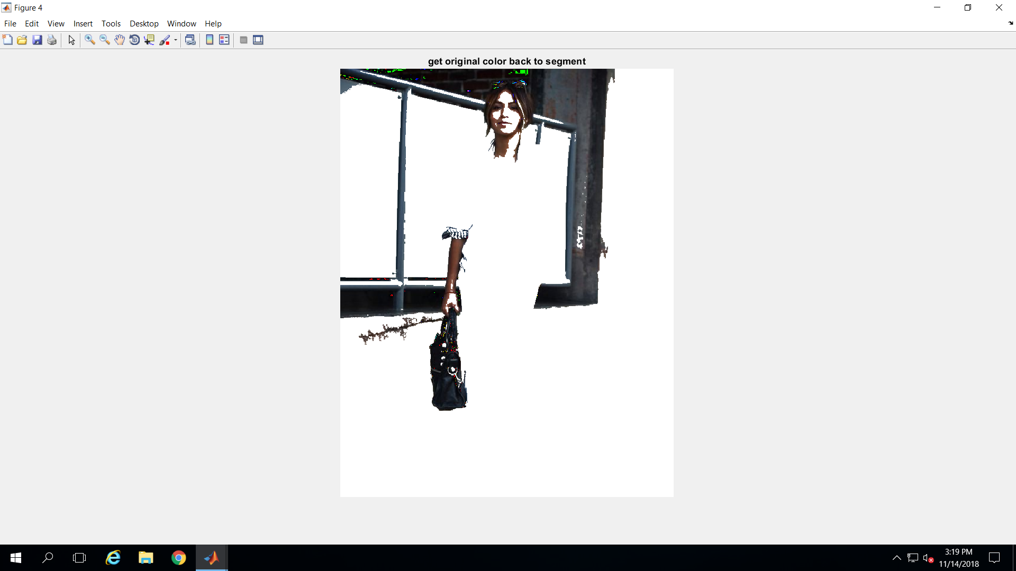



more results
only recognizable item segmented from image to the left
test with model – this is first pass, largest ‘object’

Slide 26
future work
fine tuning binarizing process may help
I tried 3 different binarizing methods
the simple “I2 = Ig < 100” worked the best for this set of 14 images
quadtree decomposition (qtdecomp)
I am curious whether I could incorporate this somewhere in the process. I tried to run it using the code straight from the MATLAB documentation, but I could not get the code to run
for short term, GrabCut is probably the best solution. GrabCut is an image segmentation method based on graph cuts. Starting with a user-specified bounding box around the object to be segmented, the algorithm estimates the color distribution of the target object and that of the background using a Gaussian mixture model.
my goal was to have an automated process with no user intervention

Slide 27






DOGS
+
CATS =
DOGS +
CATS =

